Slide 1
Ridge Route Conditions by Michael F Ballard
January 2022

Slide 2
Current Conditions
Recent storms have cause numerous rockslides
October CUTRR work location needs to be cleared again
Swedes Cut is clogged with debris and rockslides
Roadway is no longer passable by a standard auto in a few locations
Culverts are blocked in numerous locations

Slide 3
Sandberg to Tumble Inn
January 2022 Ridge Route Conditions

Slide 4
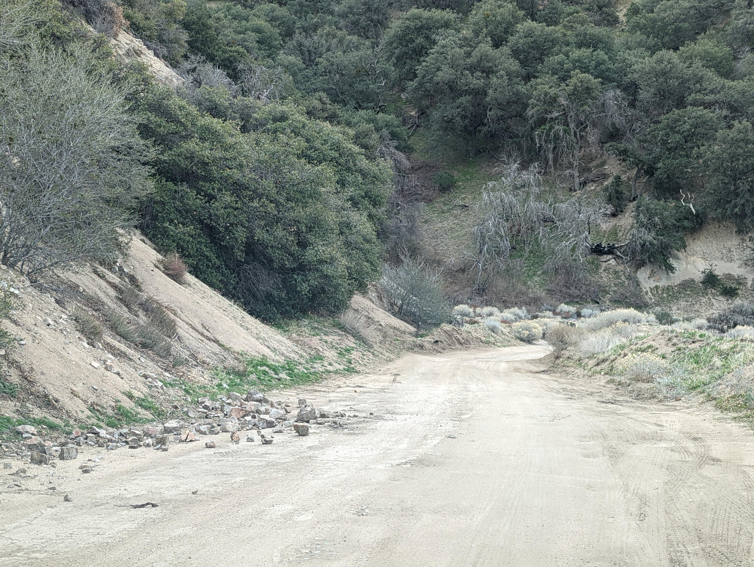
Notes:
Near Liebre Summit. Small rockfall from December 2021 / January 2022

Slide 5
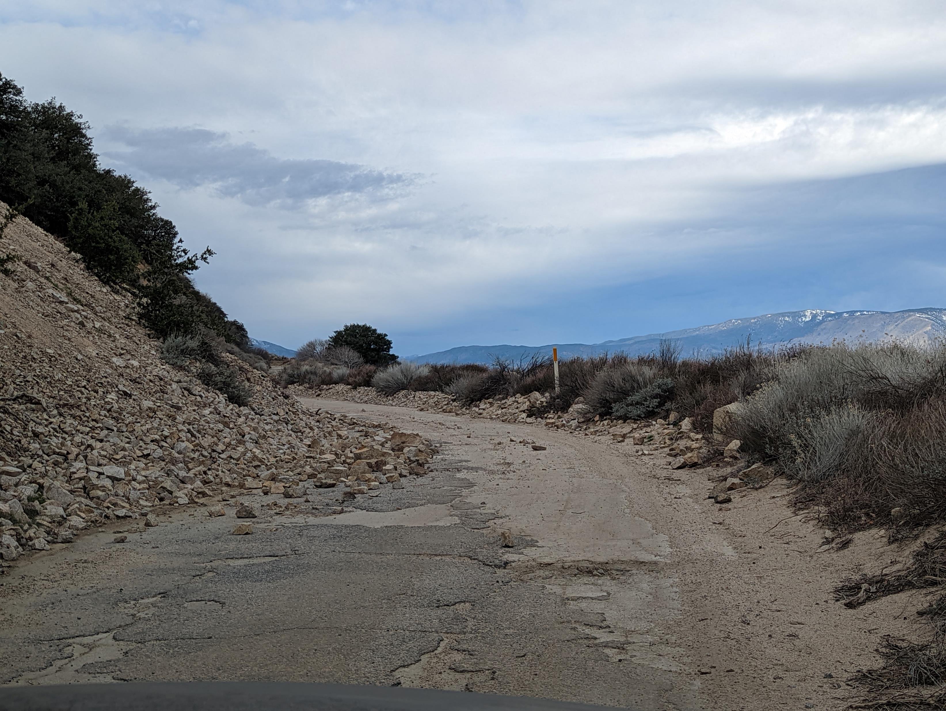
Notes:
Near Liebre Summit. Small rockfall from December 2021 / January 2022.

Slide 6
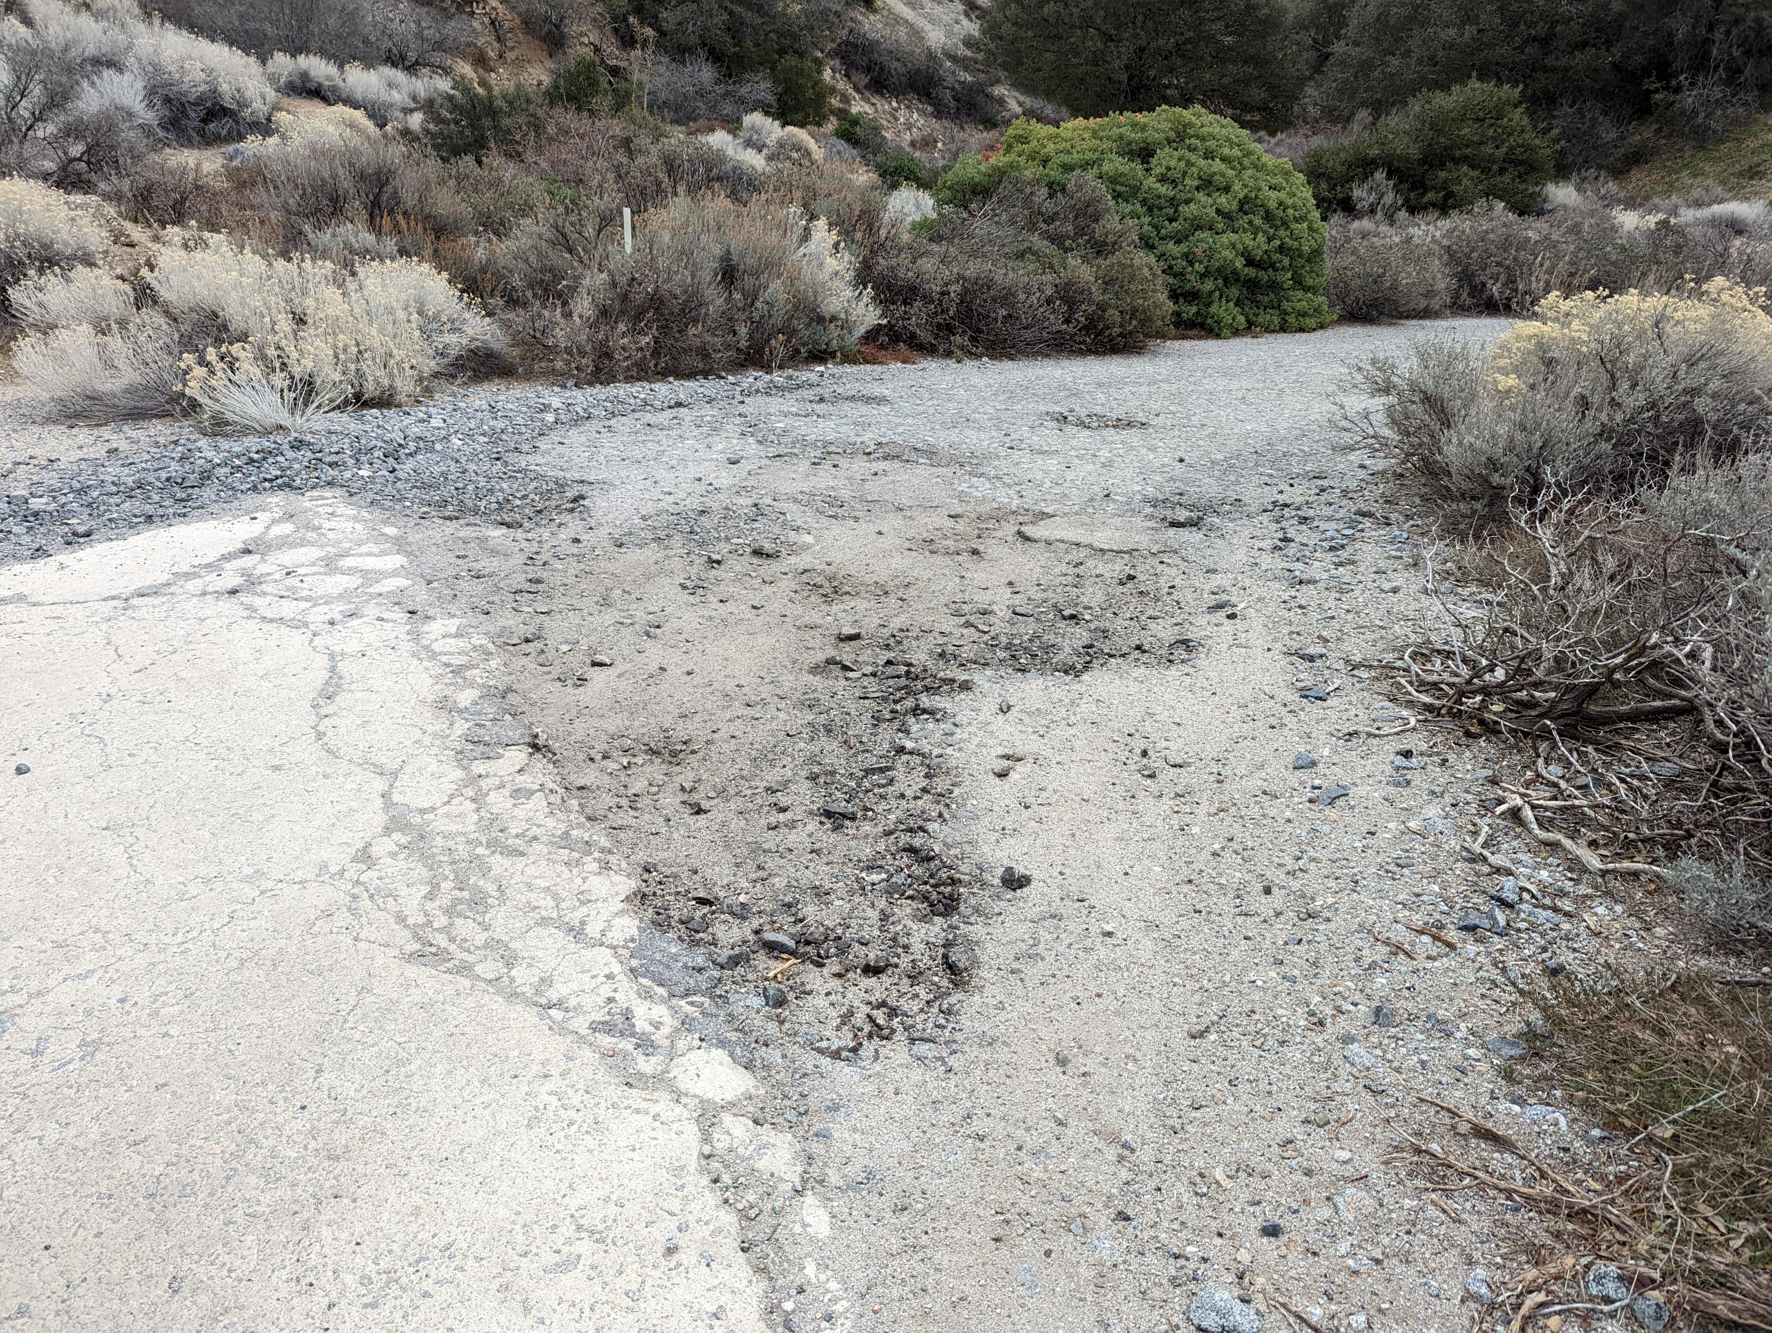
Notes:
Horseshoe Curve. Potholes developing in 1923-1927 asphalt paving.

Slide 7
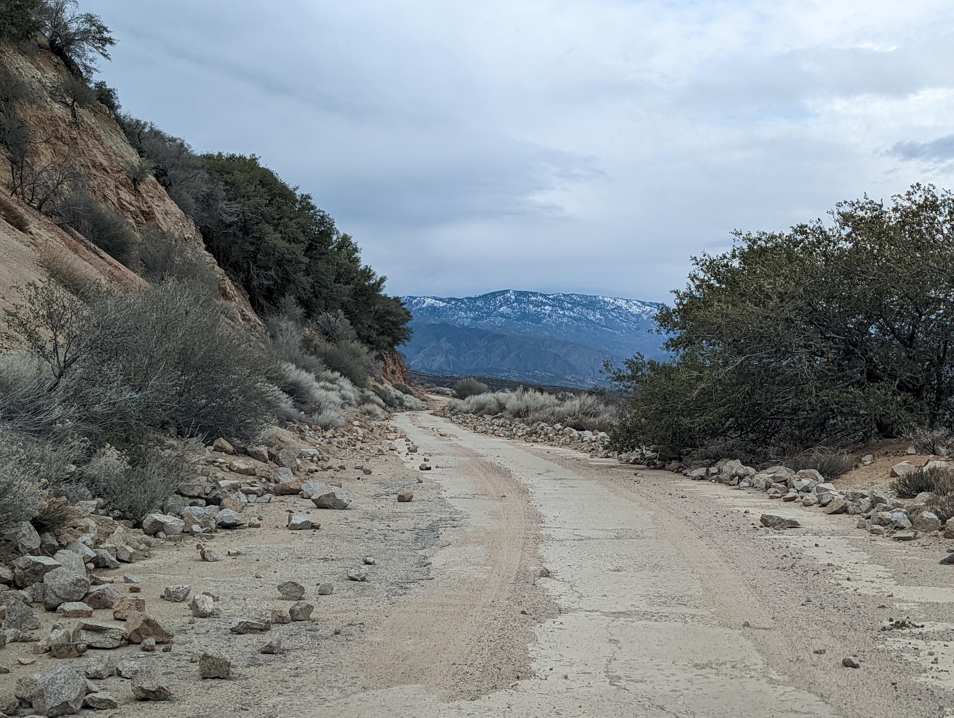
Notes:
Near Granite Gate. Small rockfall from December 2021 / January 2022.

Slide 8
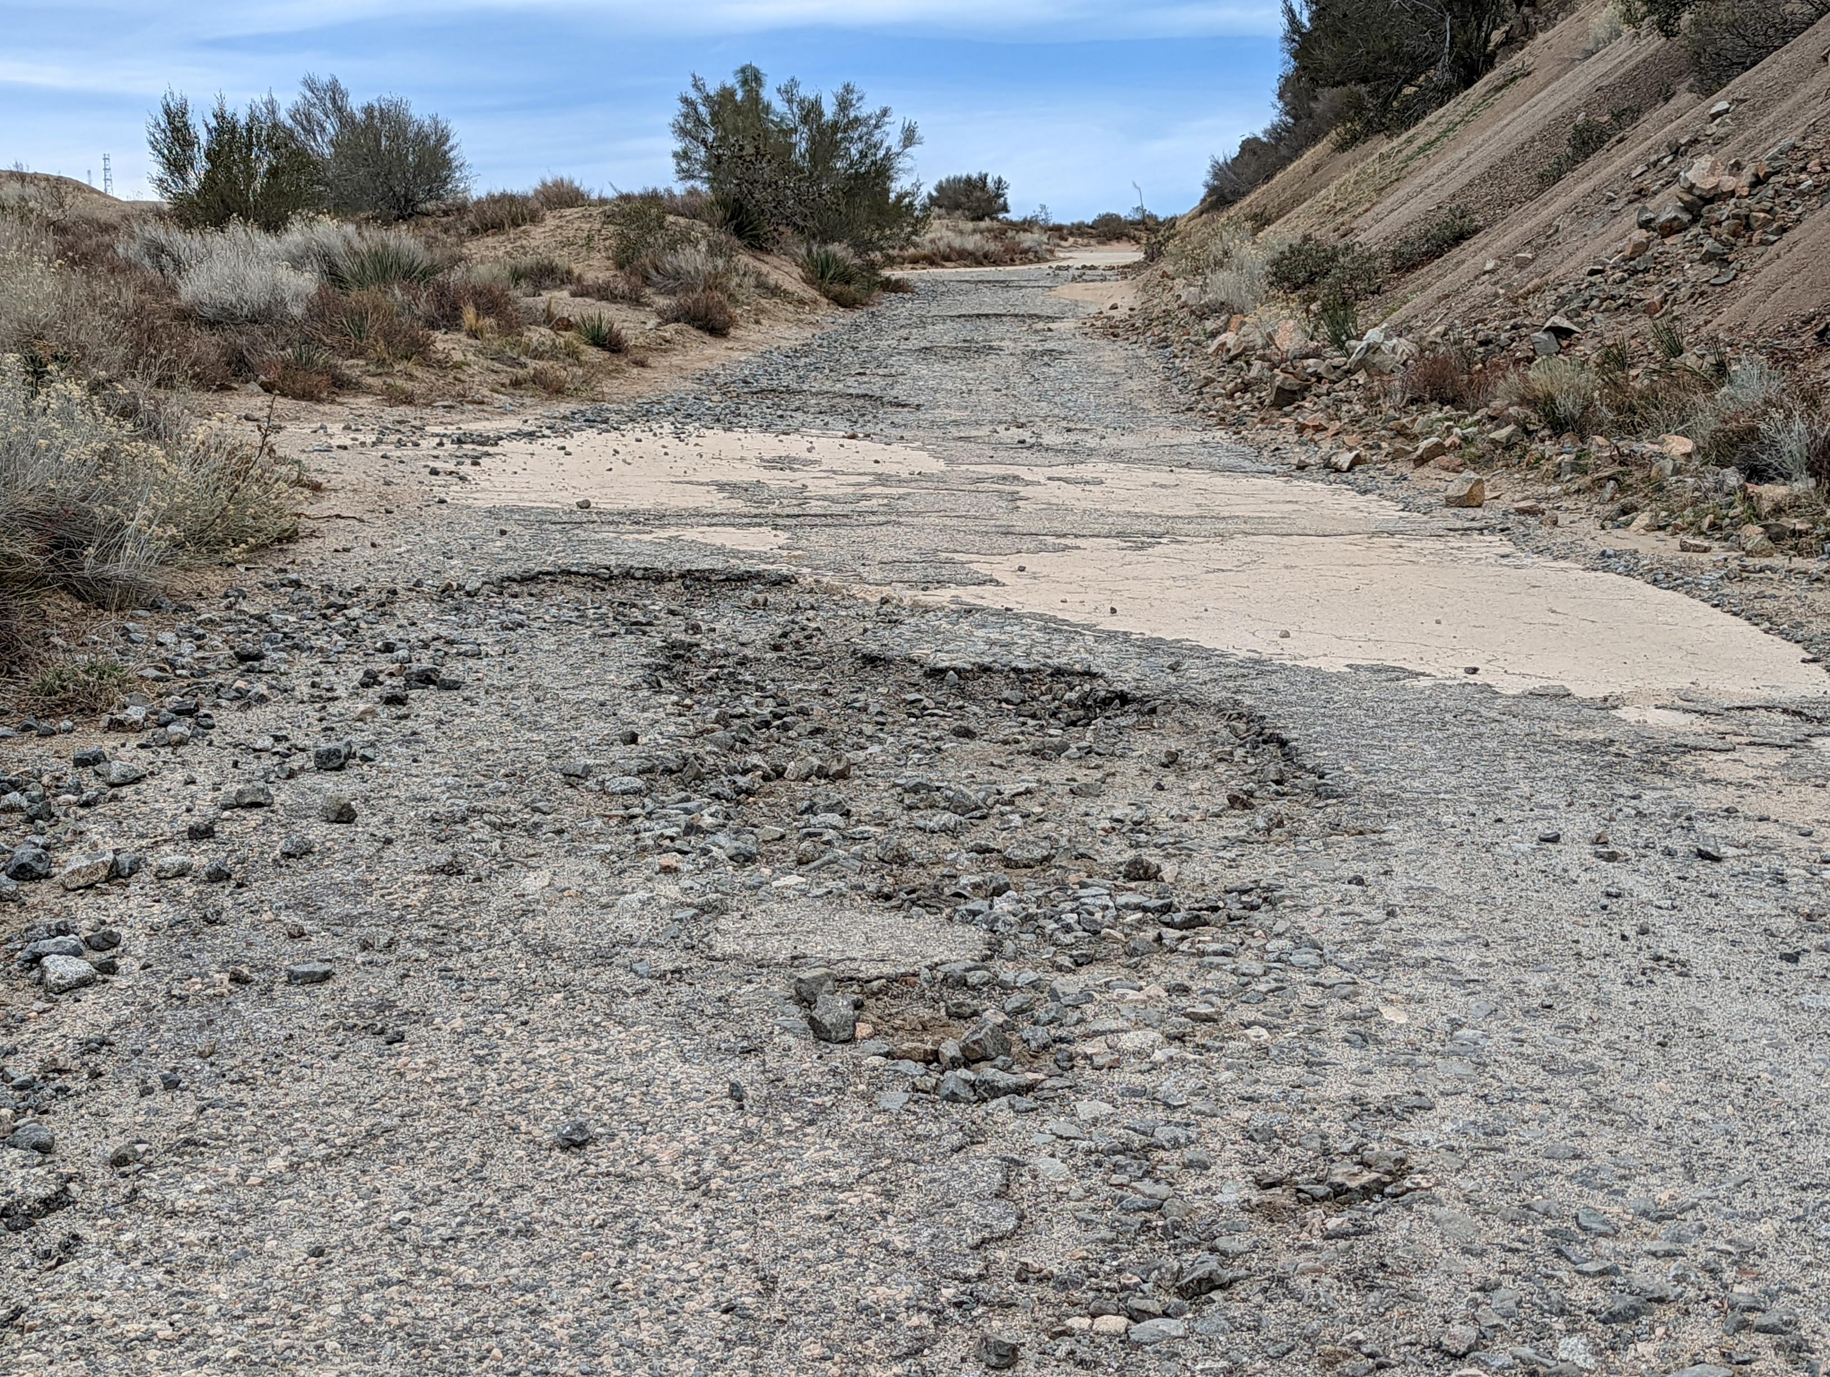
Notes:
Near Granite Gate. Potholes developing in asphalt at concrete interface.

Slide 9
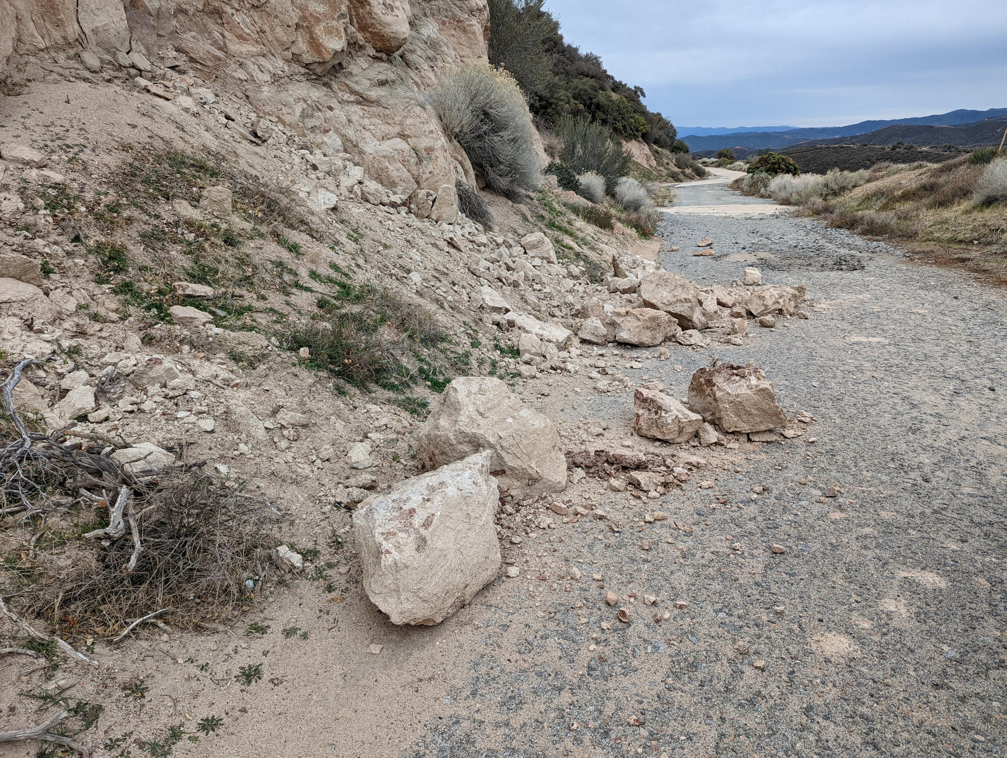
Notes:
At Granite Gate. Small rockfall from December 2021 / January 2022.

Slide 10
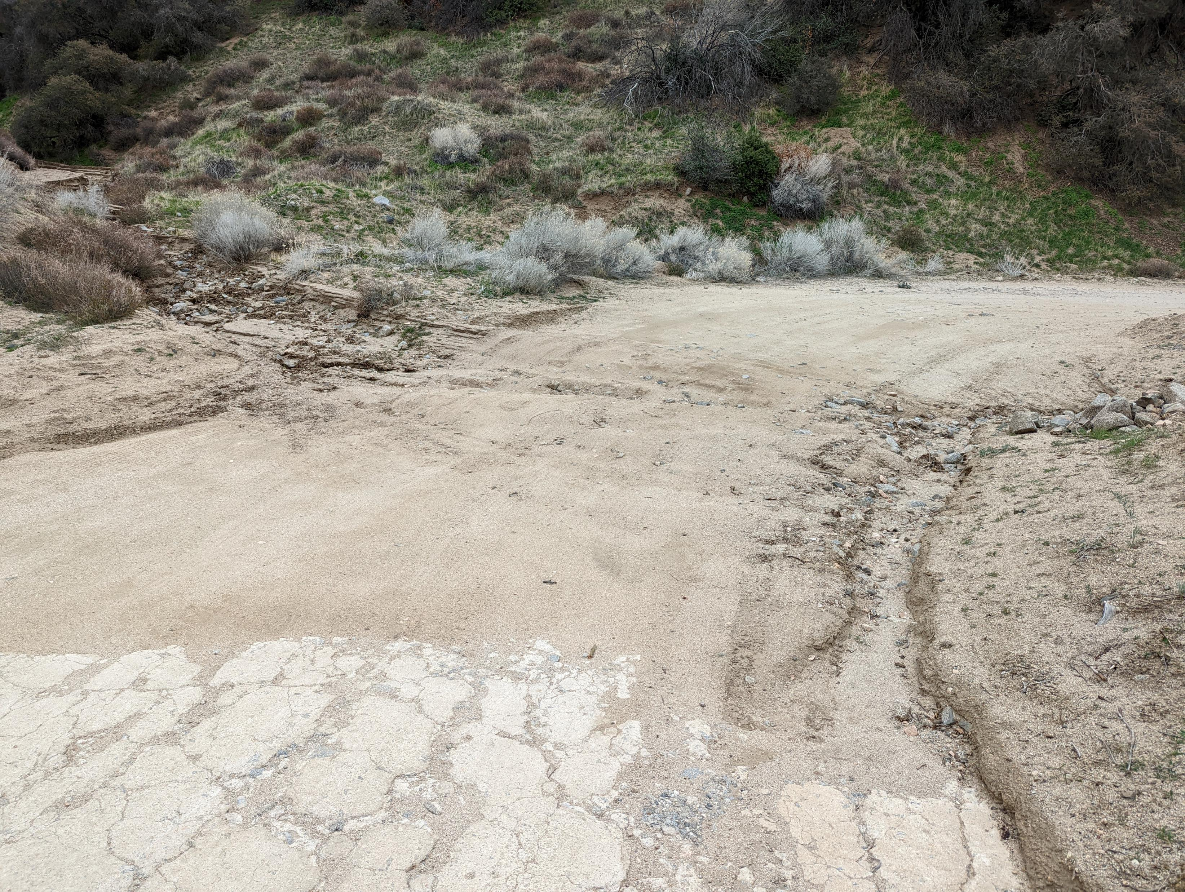
Notes:
Near Liebre Maintenance Station. Culvert was blocked and a large amount of material has covered the roadway. Work done in October 2021.

Slide 11
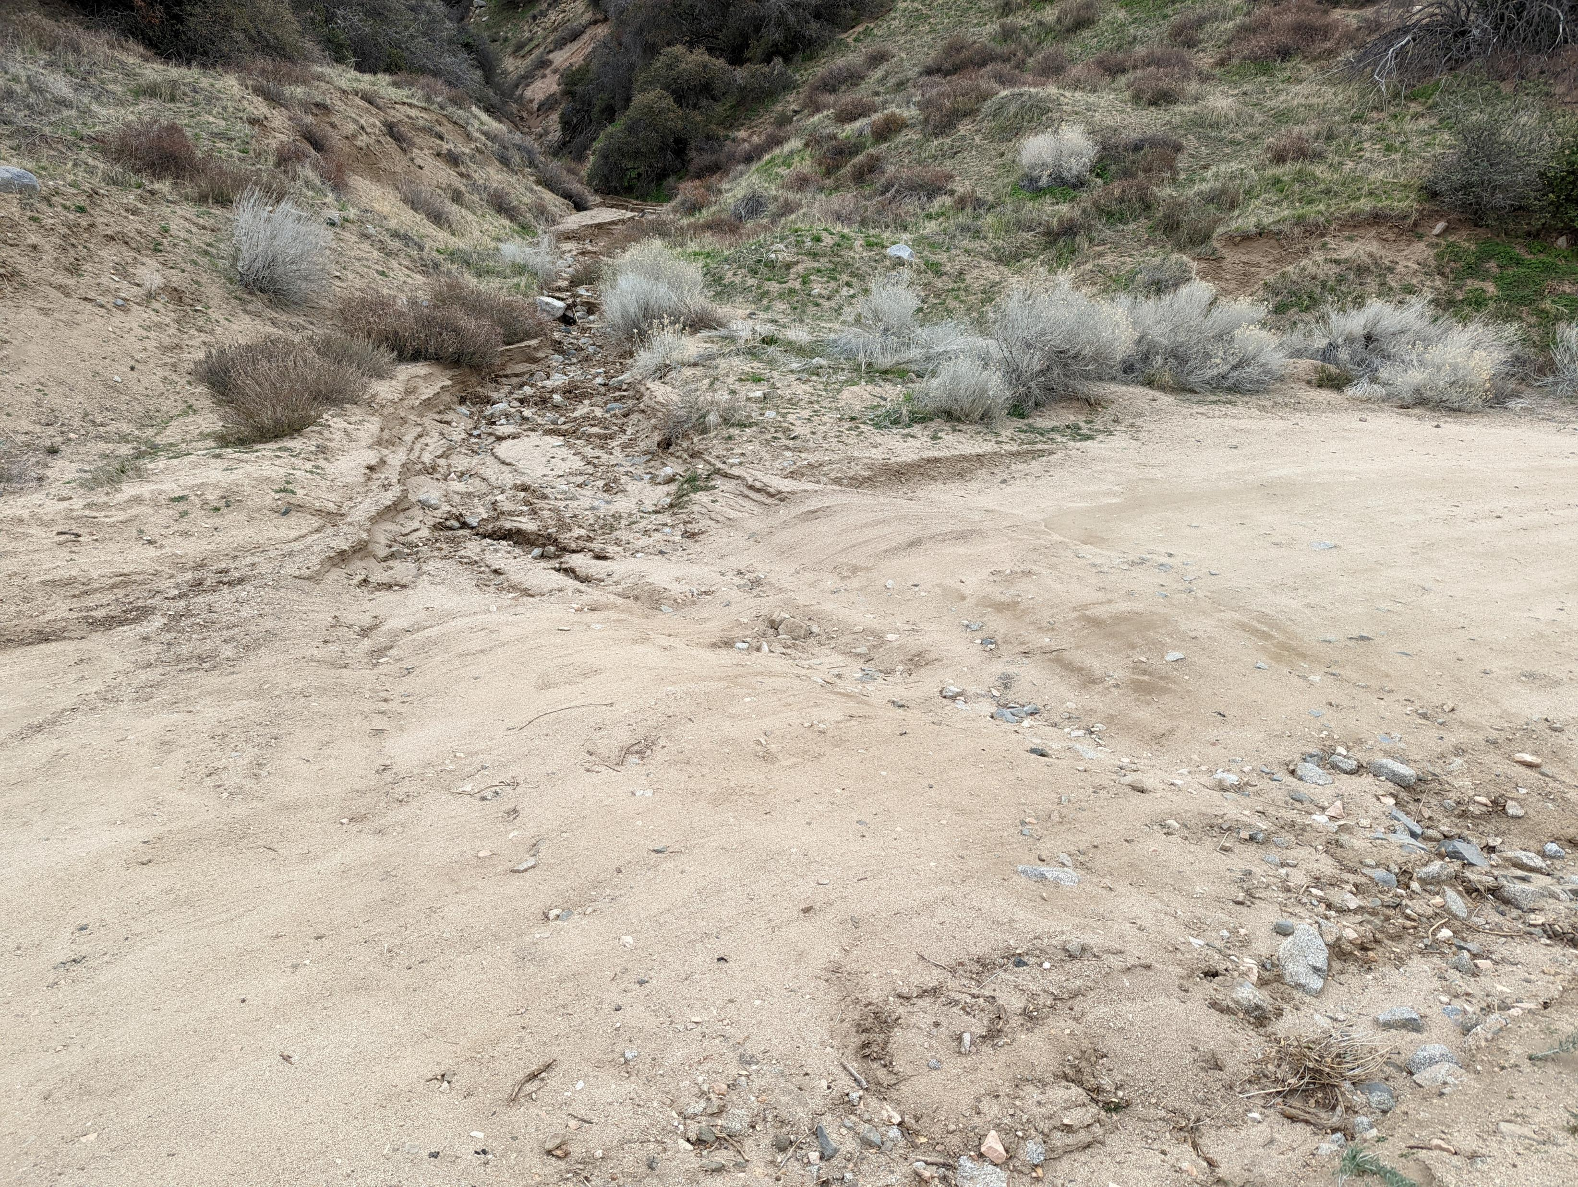
Notes:
Near Liebre Maintenance Station. Culvert was blocked and a large amount of material has covered the roadway. Work done in October 2021.

Slide 12
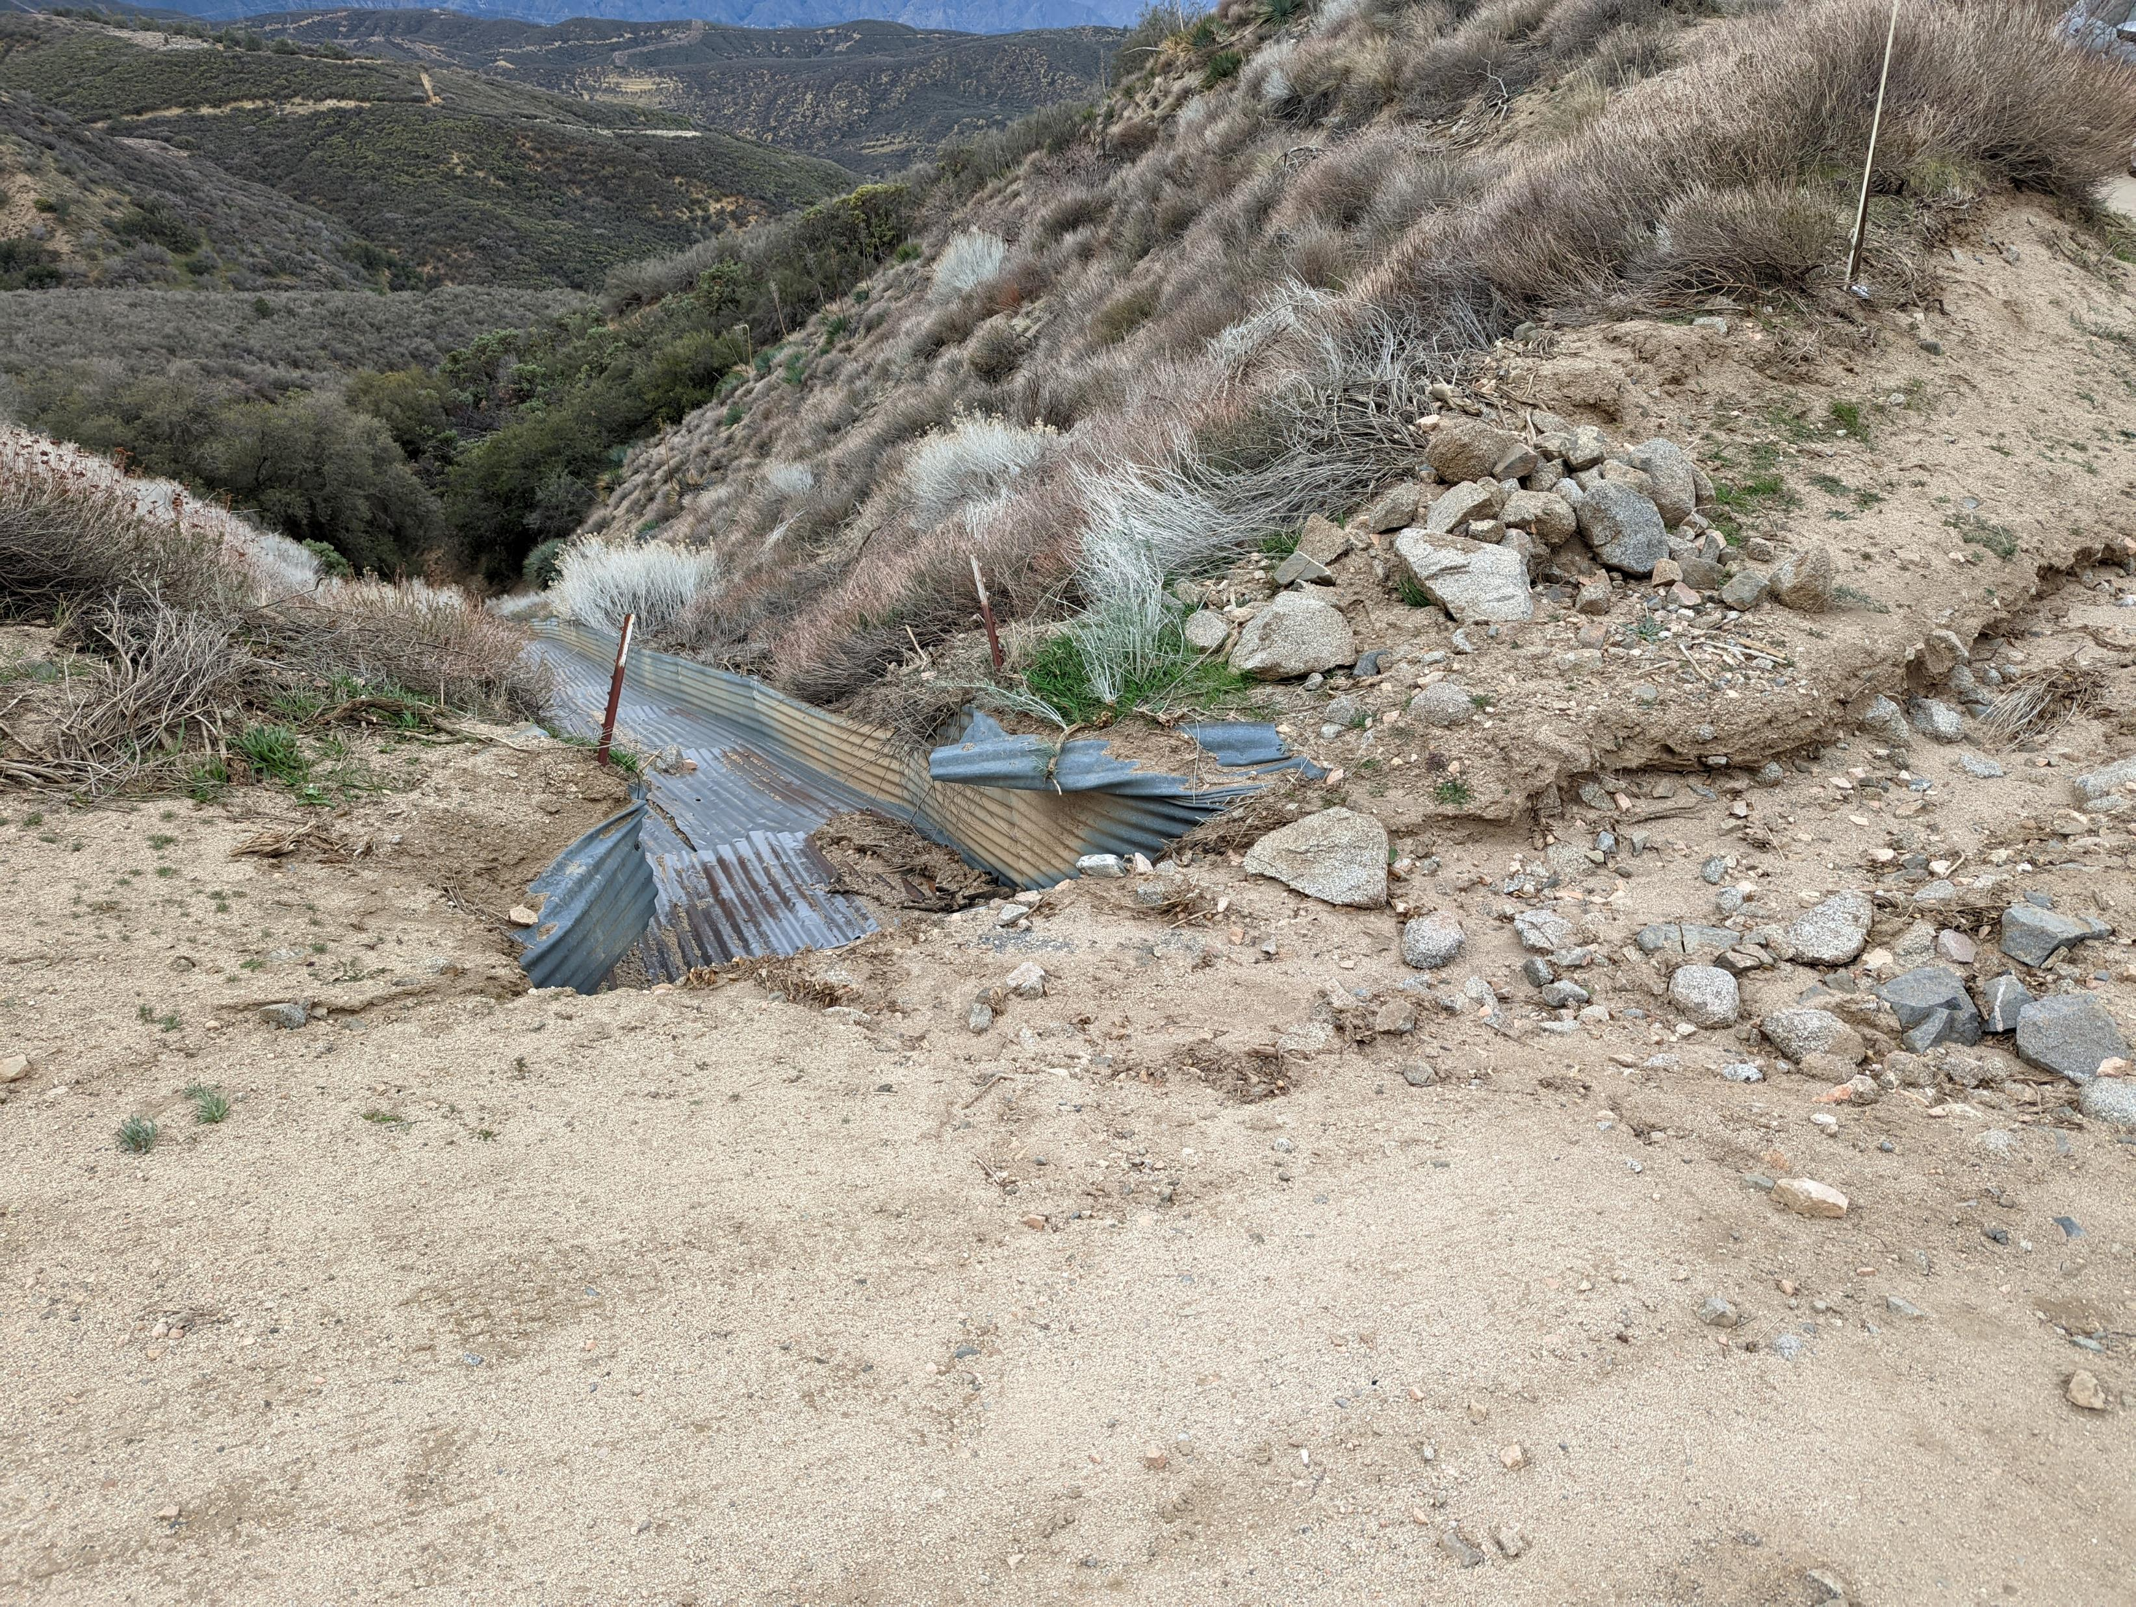
Notes:
Near Liebre Maintenance Station. Culvert was blocked and a large amount of material has covered the roadway. Work done in October 2021.

Slide 13
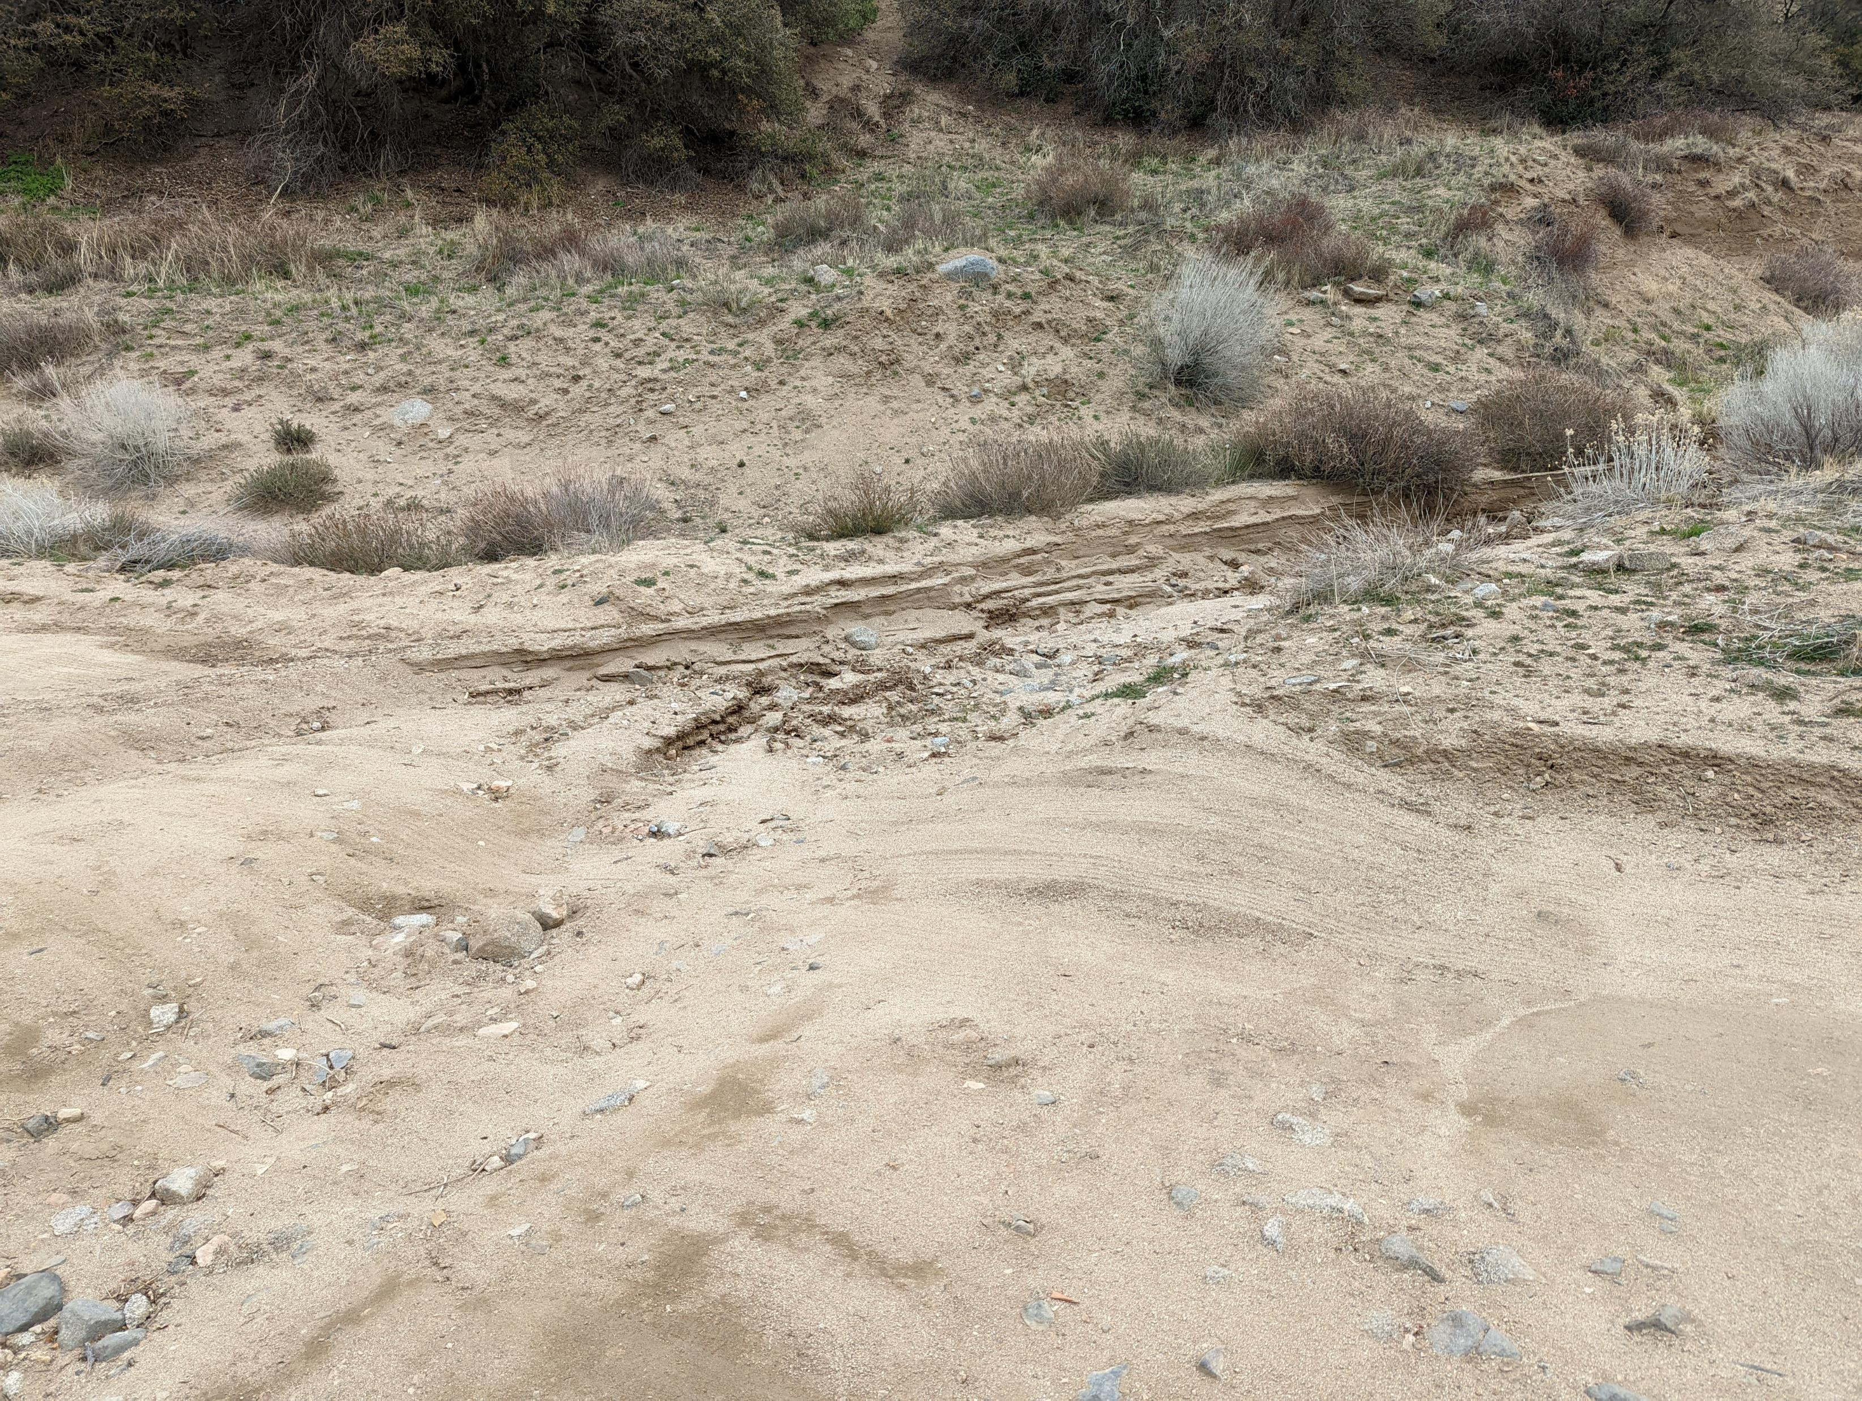
Notes:
Near Liebre Maintenance Station. Culvert was blocked and a large amount of material has covered the roadway. Work done in October 2021.

Slide 14
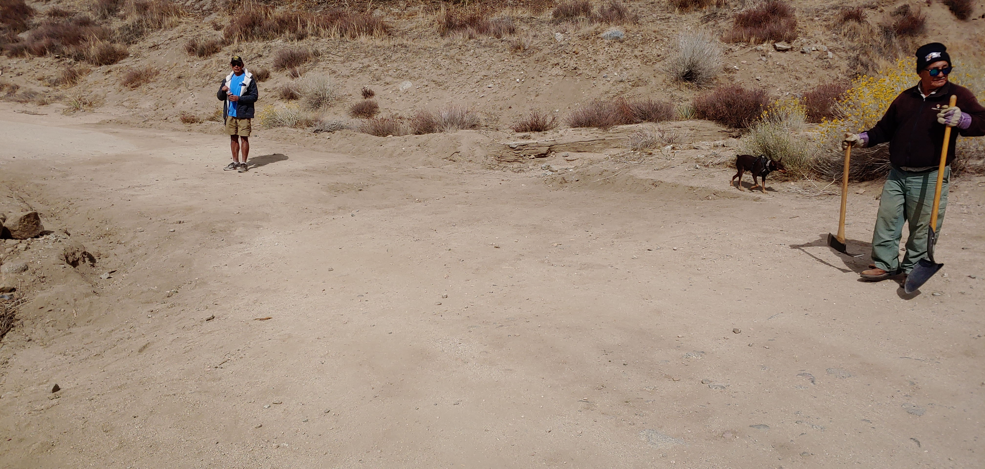
Notes:
Near Liebre Maintenance Station. Culvert was blocked and a large amount of material has covered the roadway. Work done in October 2021. Photo taken just after work was completed.

Slide 15
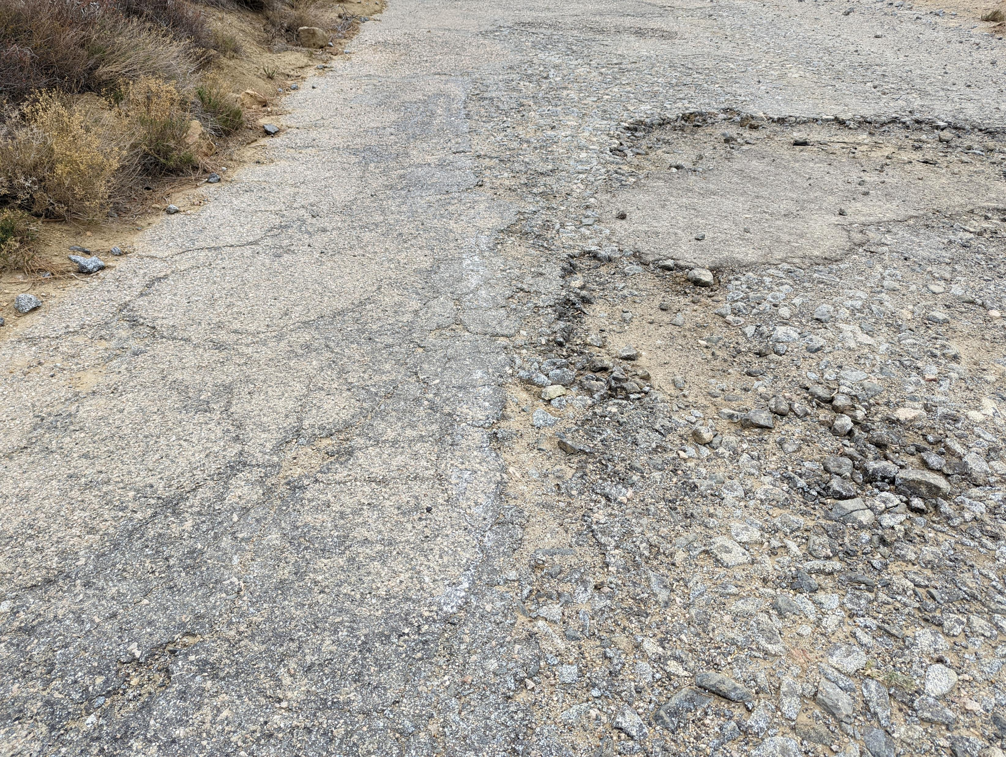
Notes:
Between Liebre Maintenance Camp and Tumble Inn. White striping still visible on 1920’s asphalt adjacent to potholes. A wholesale resurfacing would eliminate this historic resource.

Slide 16
Tumble Inn to Reservoir Summit
January 2022 Ridge Route Conditions

Slide 17
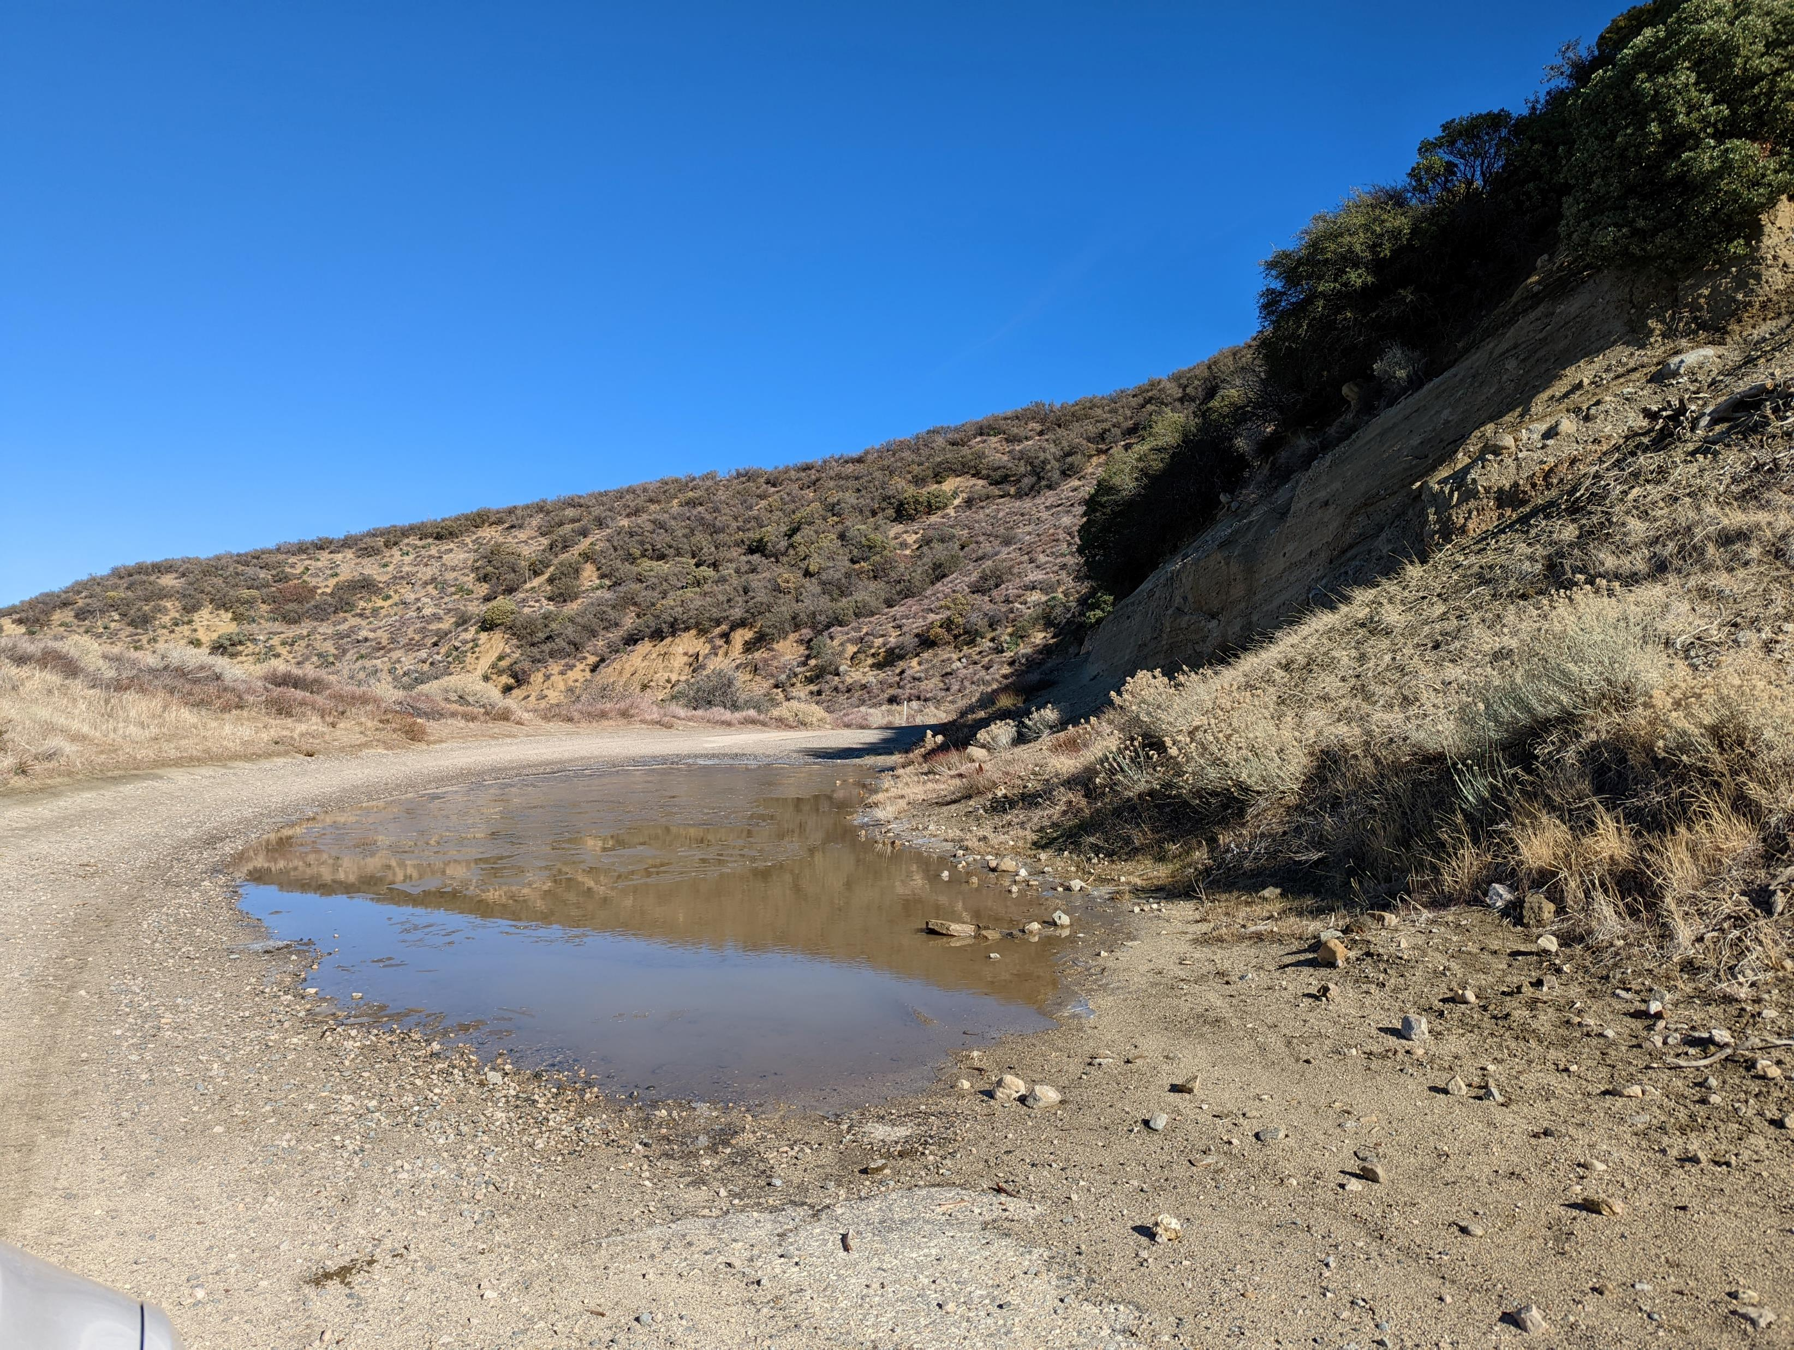
Notes:
North of Kelly’s Halfway Inn. Lack of culvert and blocked drainage has resulted in intermittent ponding at this location.

Slide 18
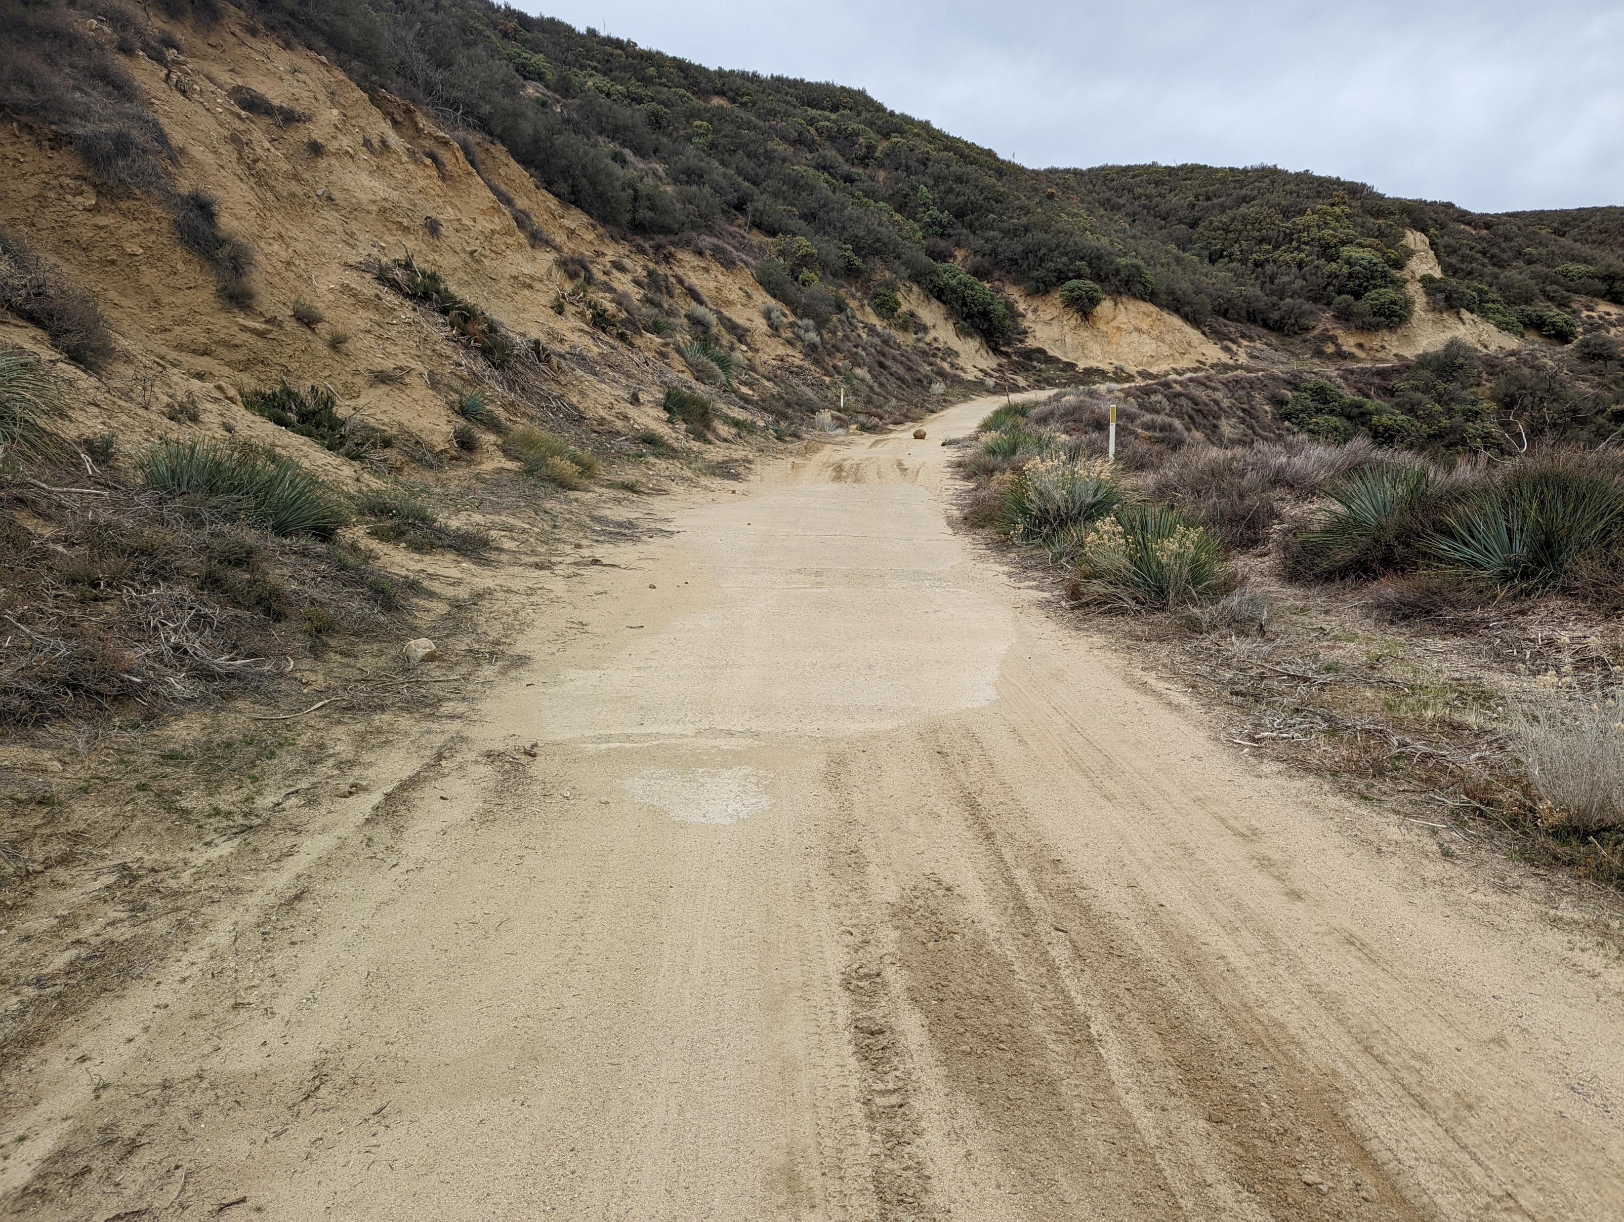
Notes:
Just north of Kelly’s Halfway Inn. Debris washing onto roadway and culverts blocked.

Slide 19
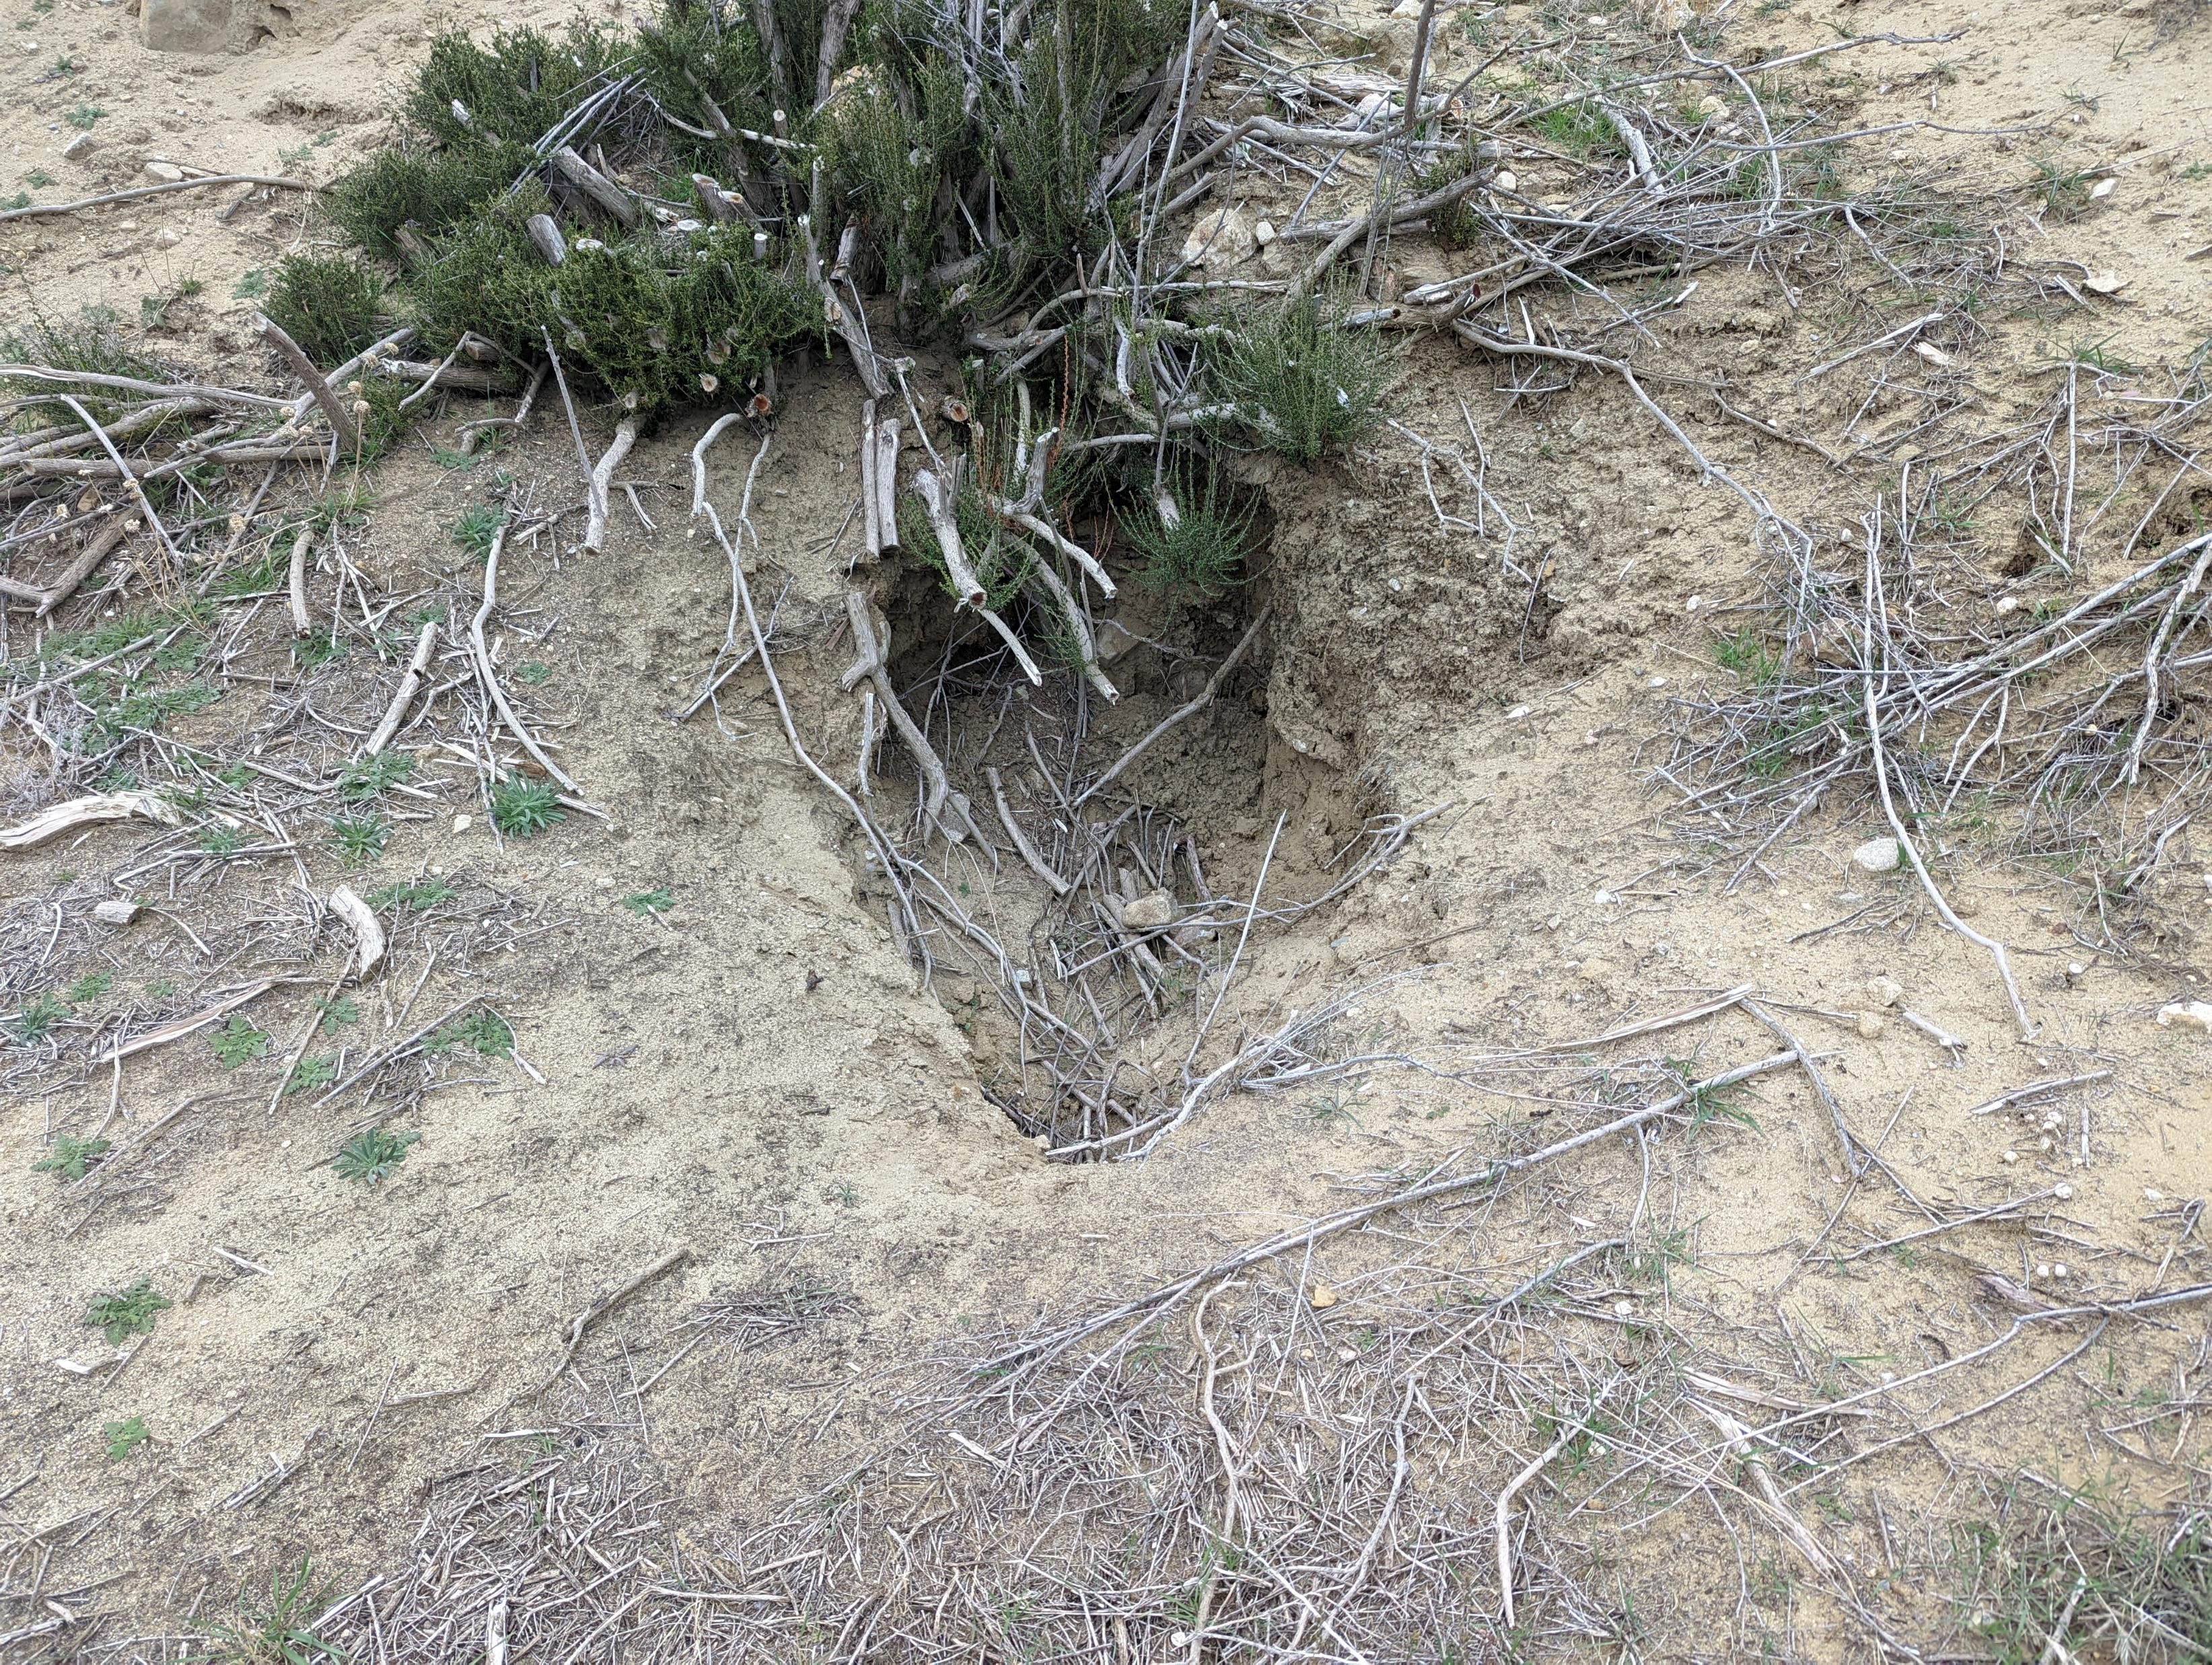
Notes:
Near Kelly’s Halfway Inn. Culvert blocked or roadway being undermined.

Slide 20
Reservoir Summit to South Gate
January 2022 Ridge Route Conditions

Slide 21
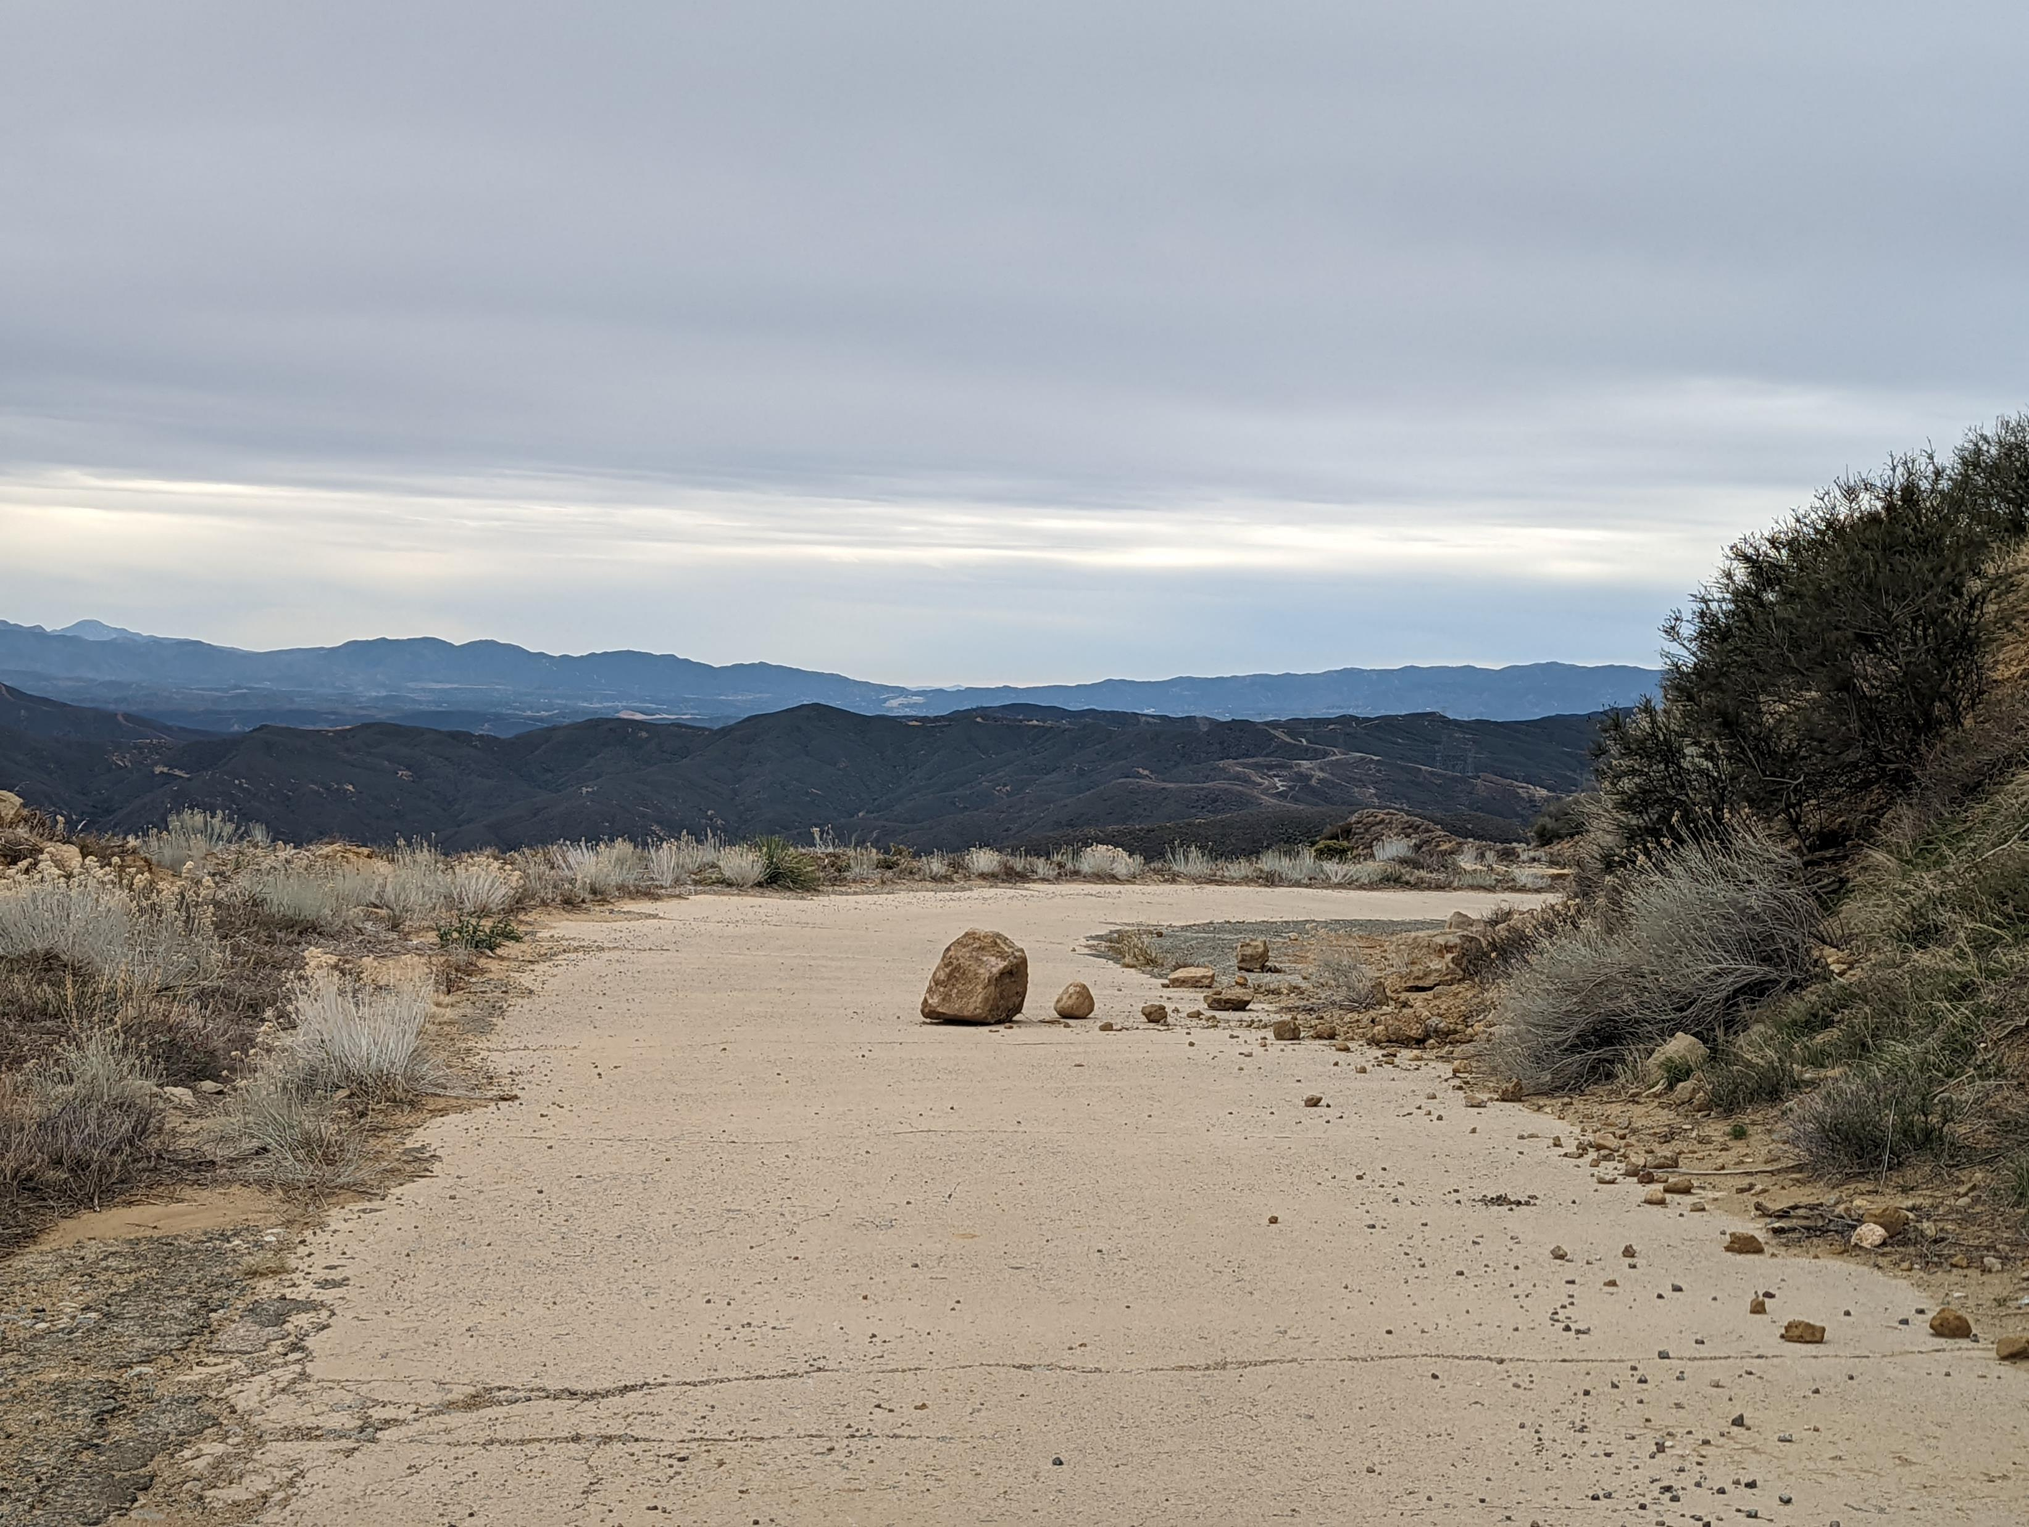
Notes:
South of Reservoir Summit. Small rockfall from January 2022.

Slide 22
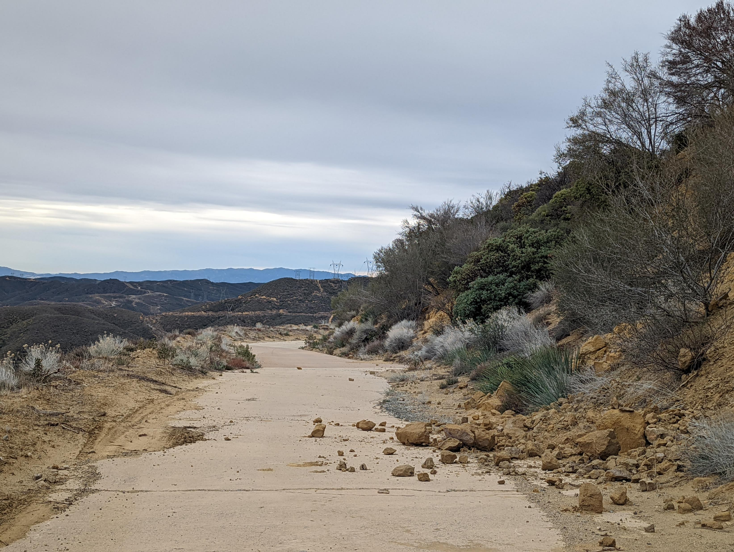
Notes:
South of Reservoir Summit. Small rockfall from January 2022.

Slide 23
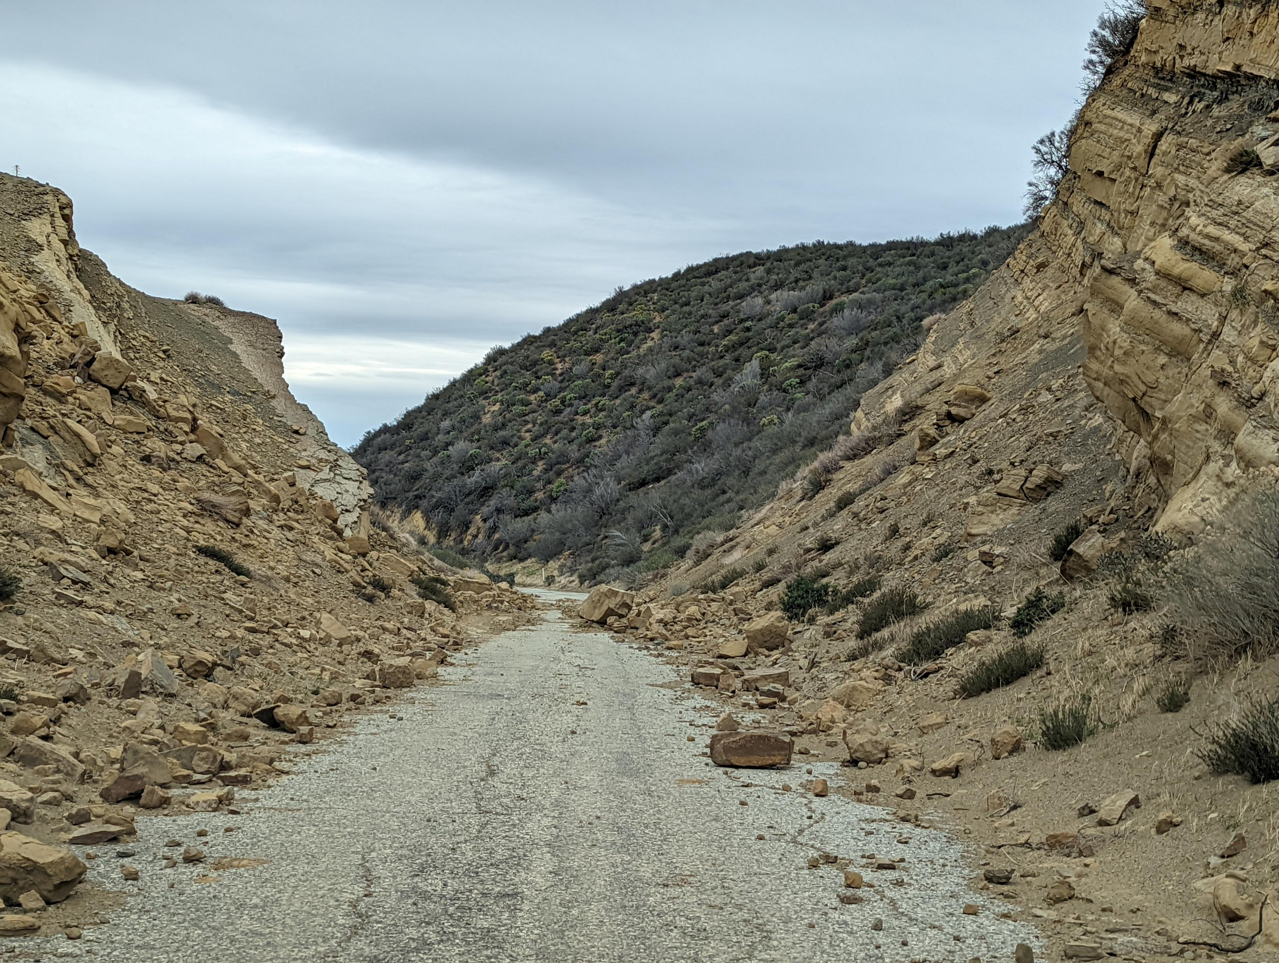
Notes:
Swede’s Cut in January 2022. Large amount of material blocking roadway.

Slide 24
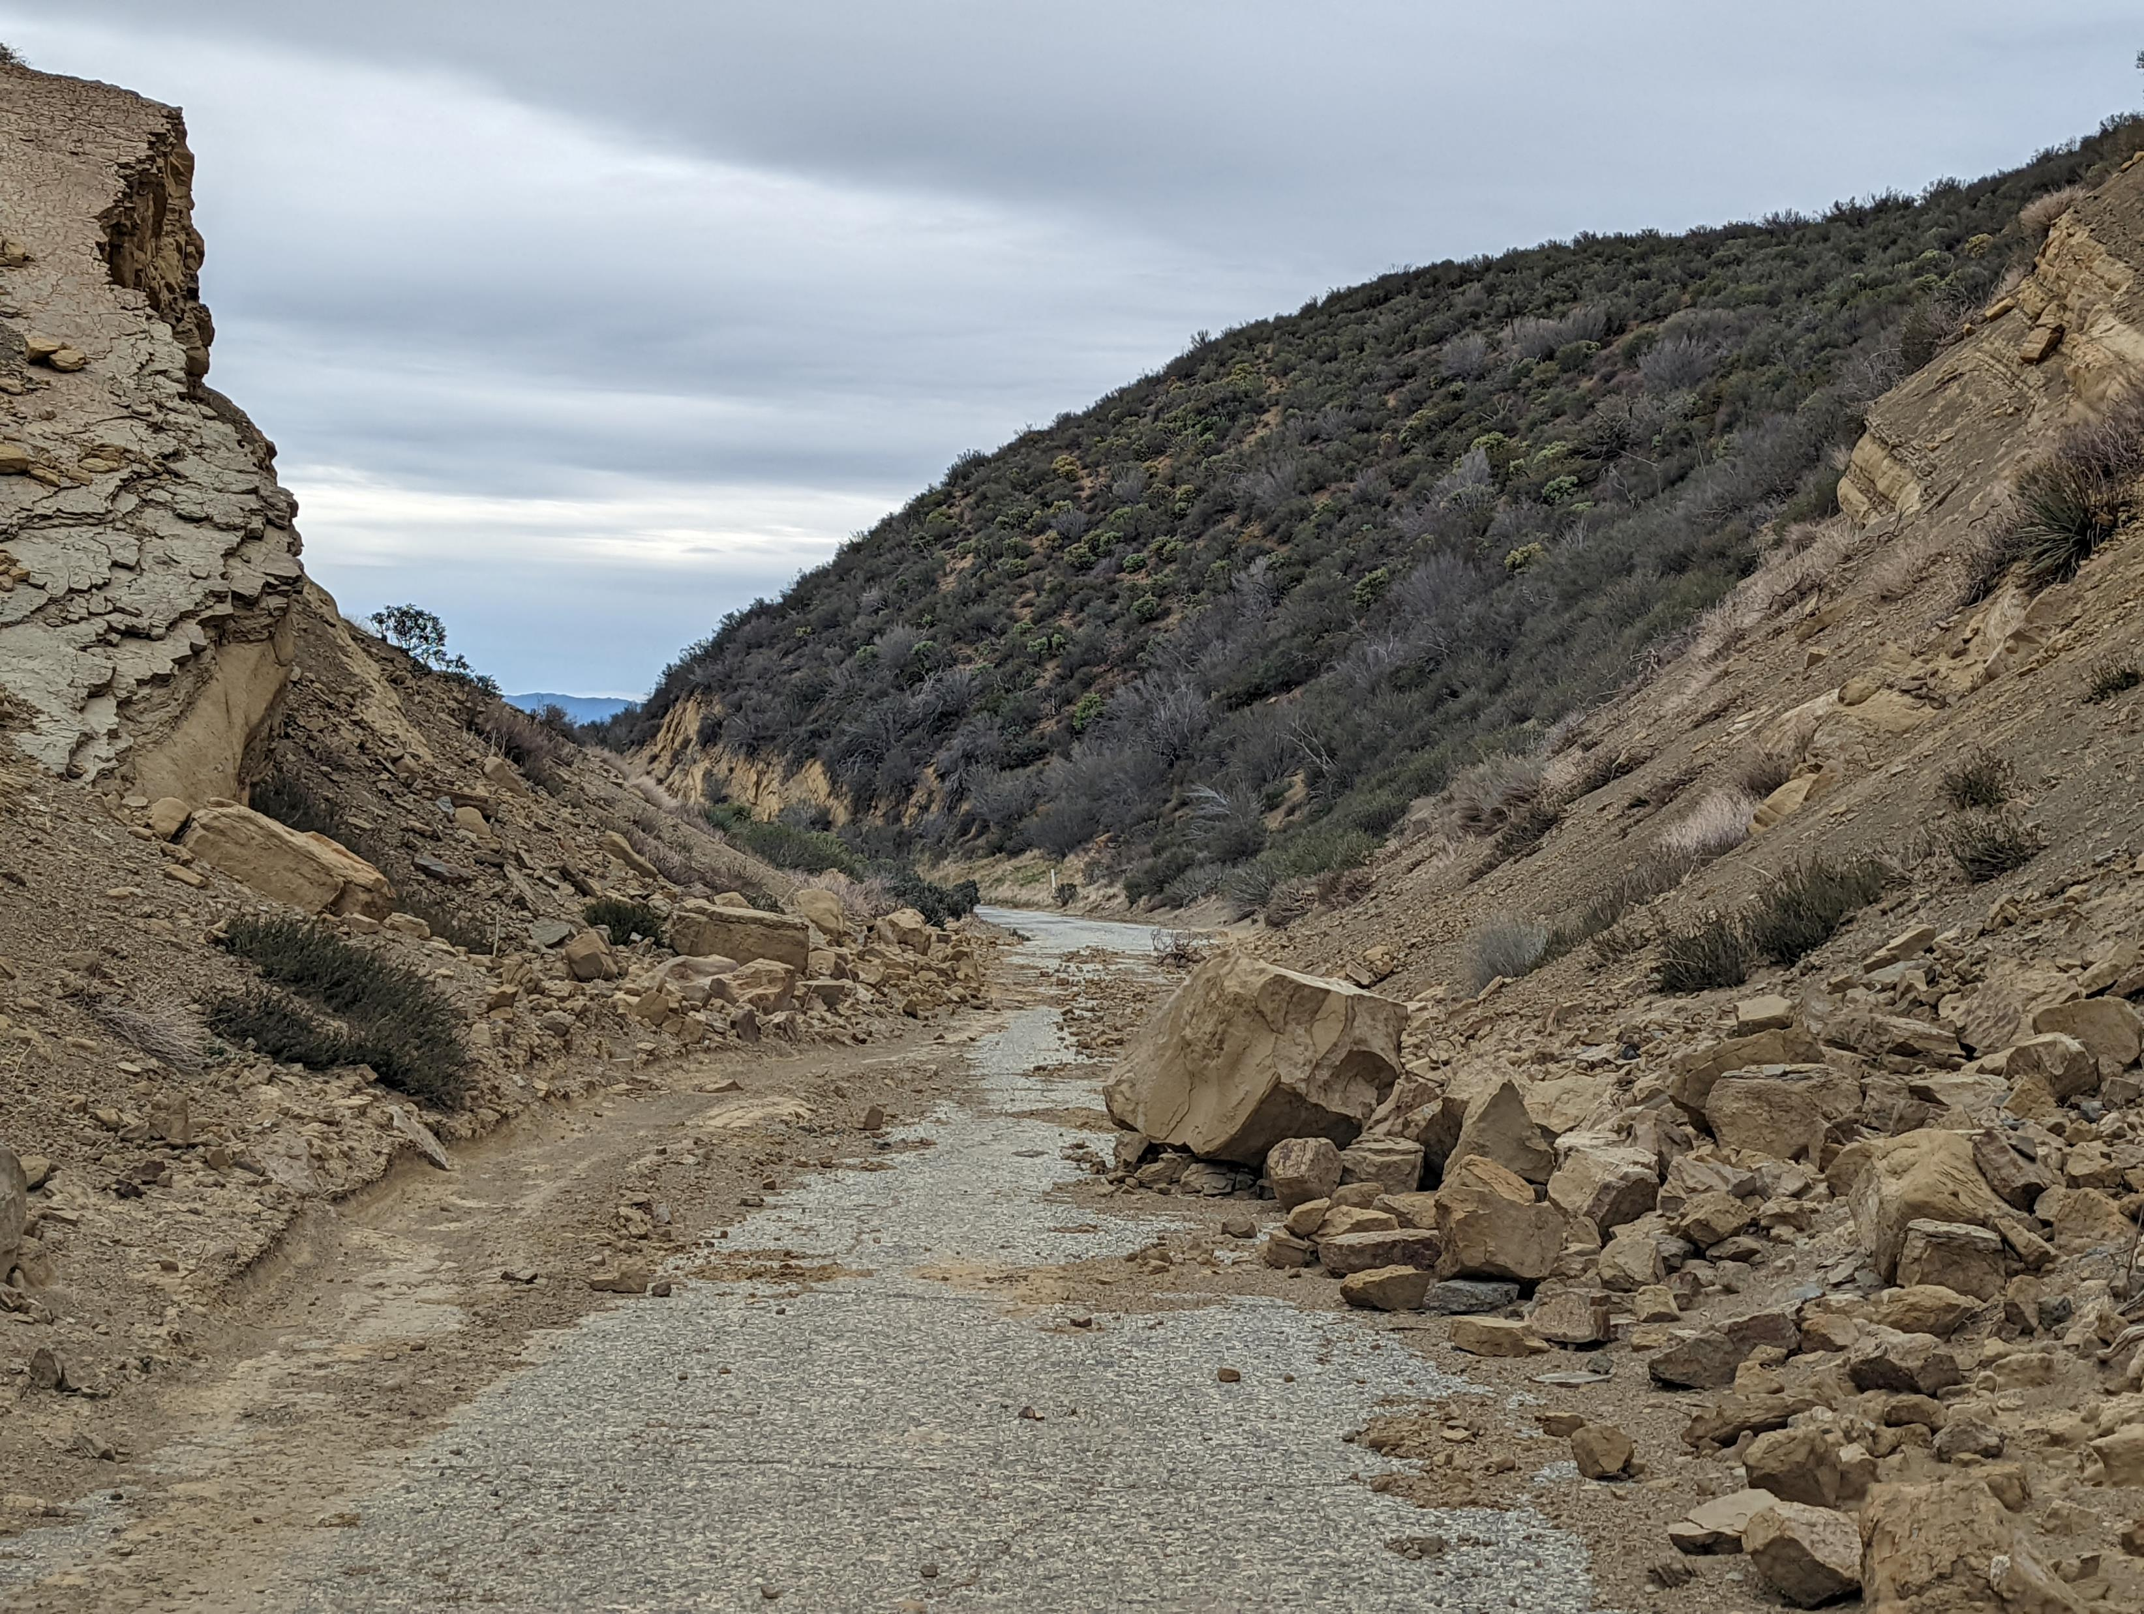
Notes:
Swede’s Cut in January 2022. Large amount of material blocking roadway.

Slide 25
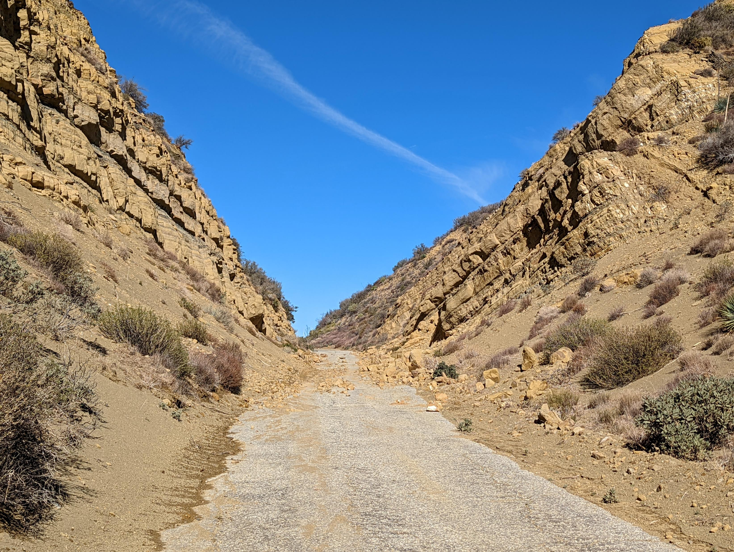
Notes:
Swede’s Cut in December 2021. Large amount of material blocking roadway.

Slide 26
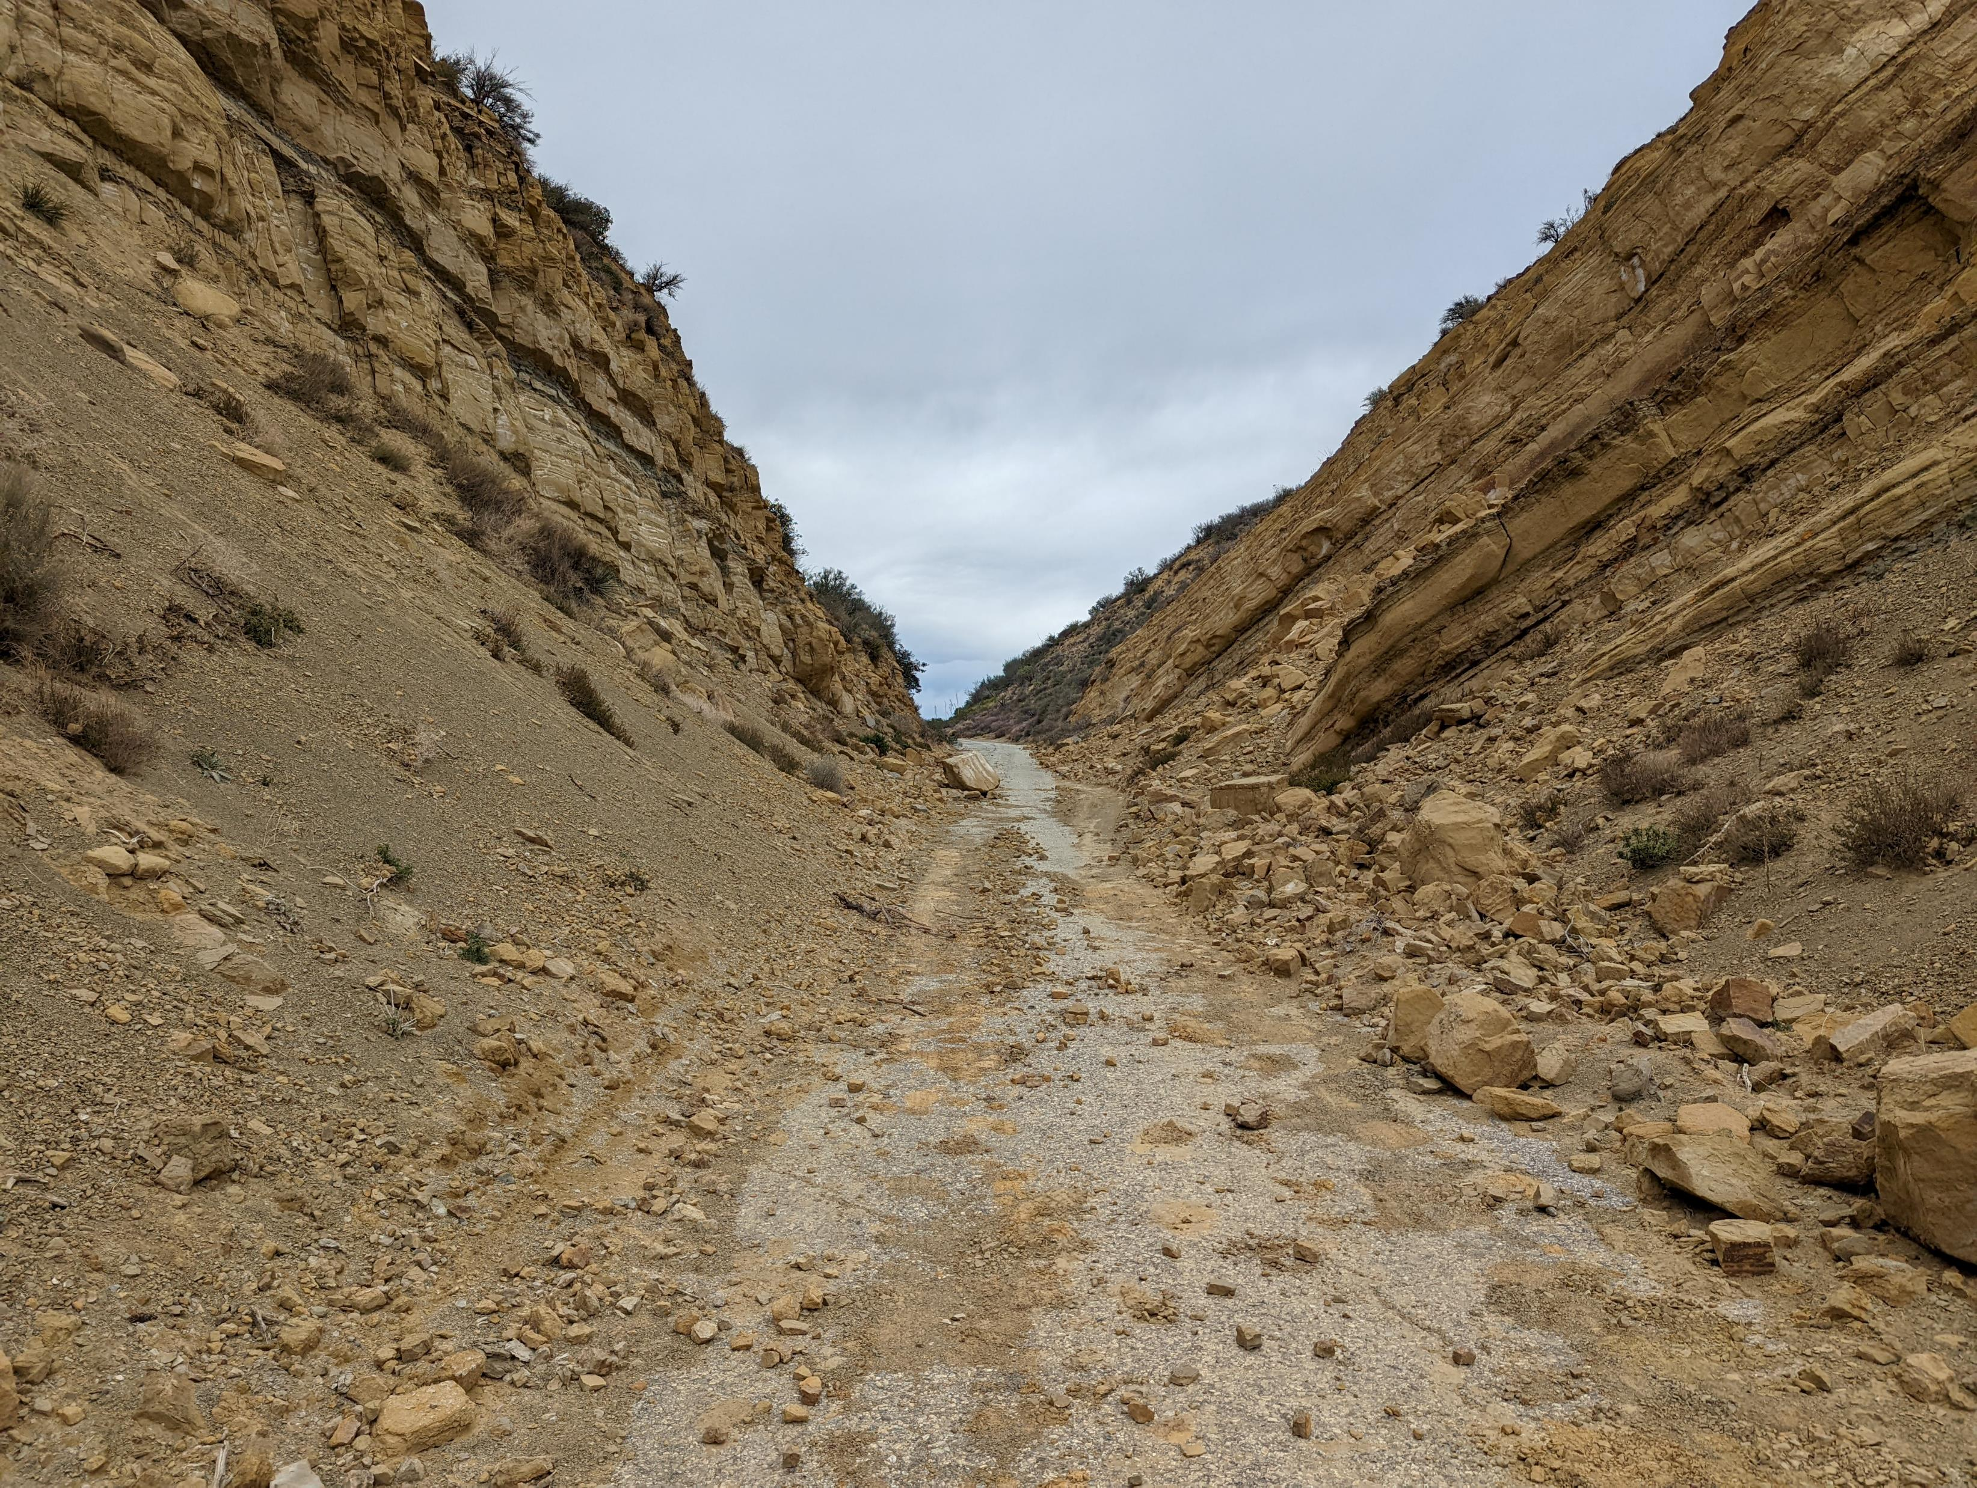
Notes:
Swede’s Cut in January 2022. Large amount of material blocking roadway.

Slide 27
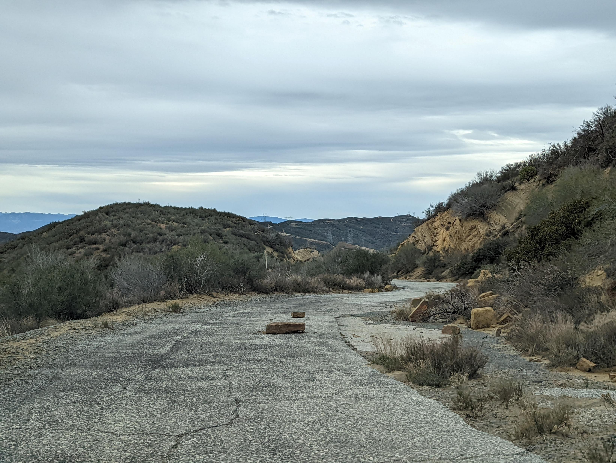
Notes:
South of Swede’s Cut in January 2022. Small rockfalls blocking roadway.

Slide 28
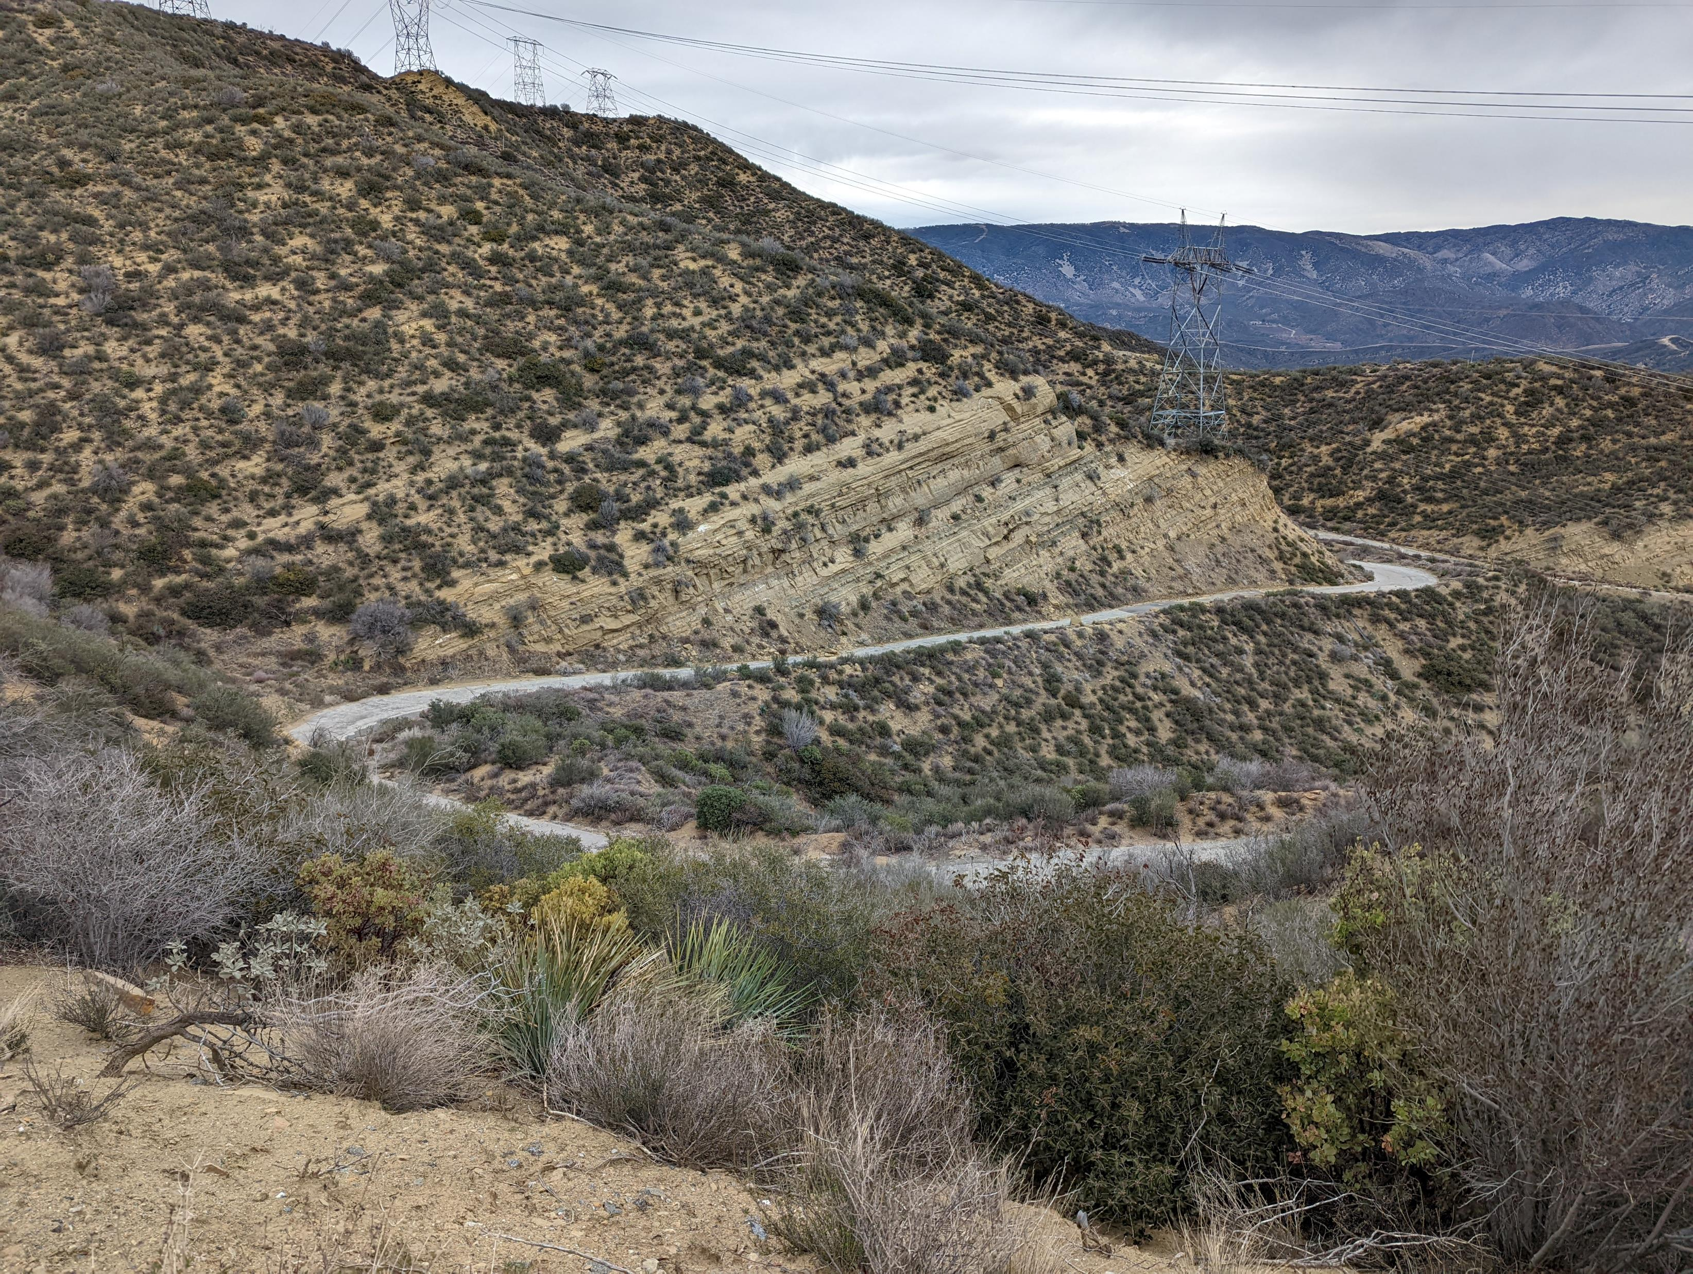
Notes:
South of Swede’s Cut in January 2022. Area of roadwork in August 2021.

Slide 29
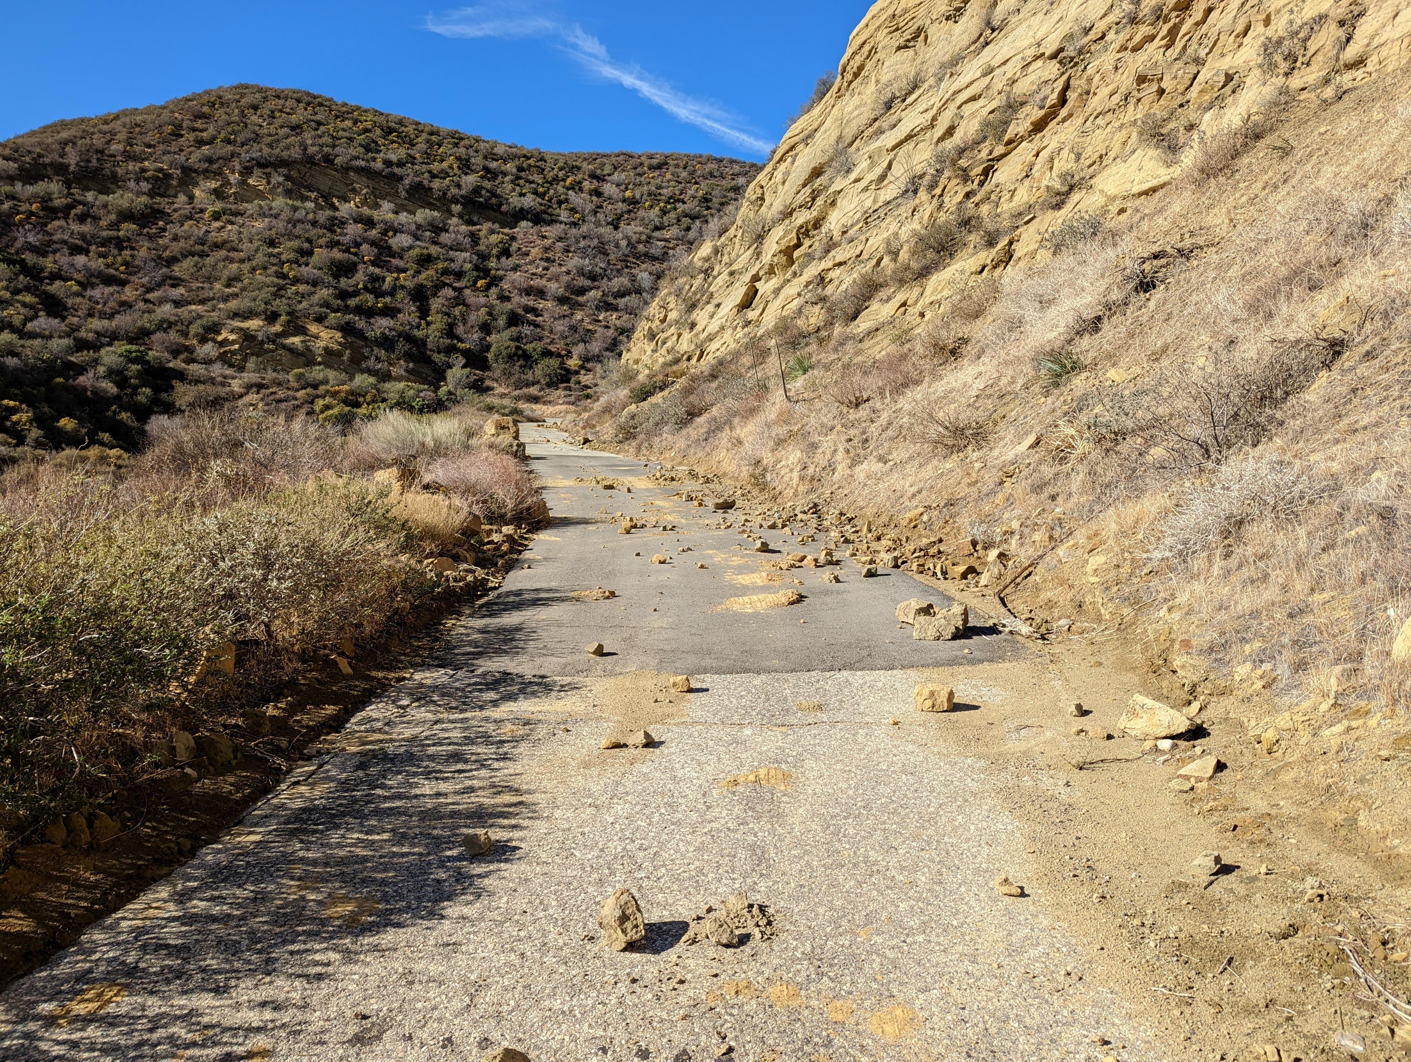
Notes:
South of Swede’s Cut in December 2021. Large amount of material blocking roadway.

Slide 30
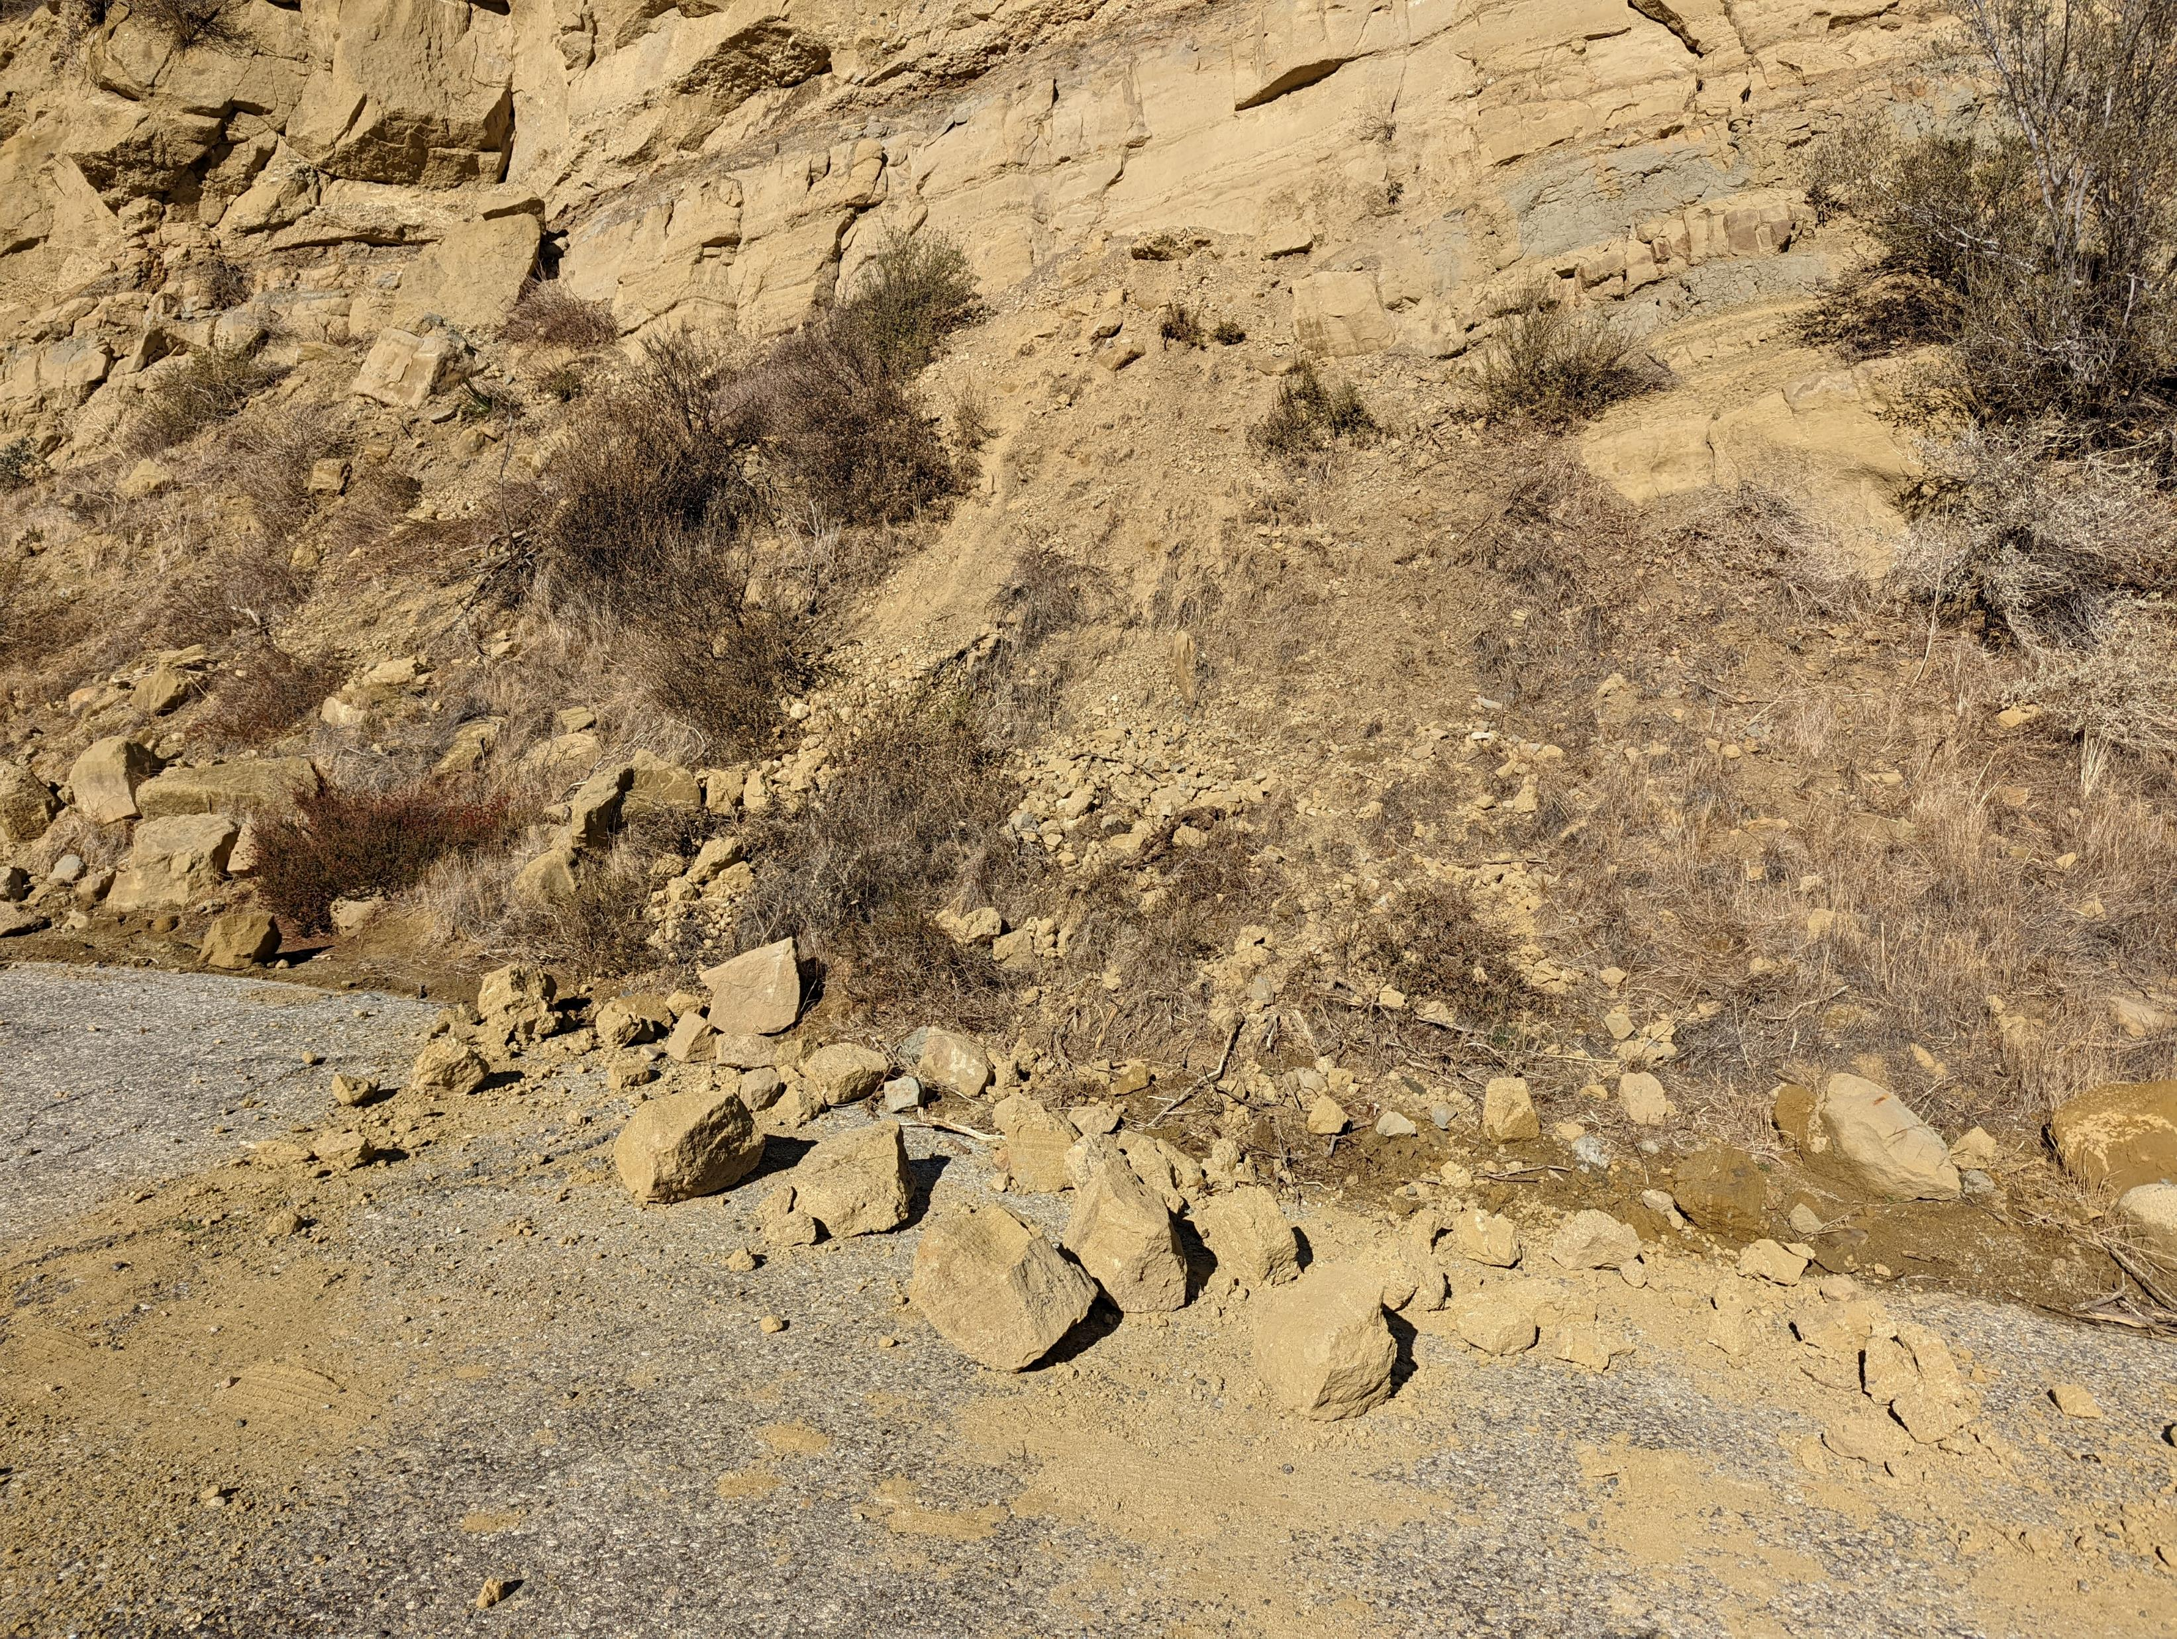
Notes:
South of Swede’s Cut in December 2021. Large amount of material blocking roadway.

