Slide 1
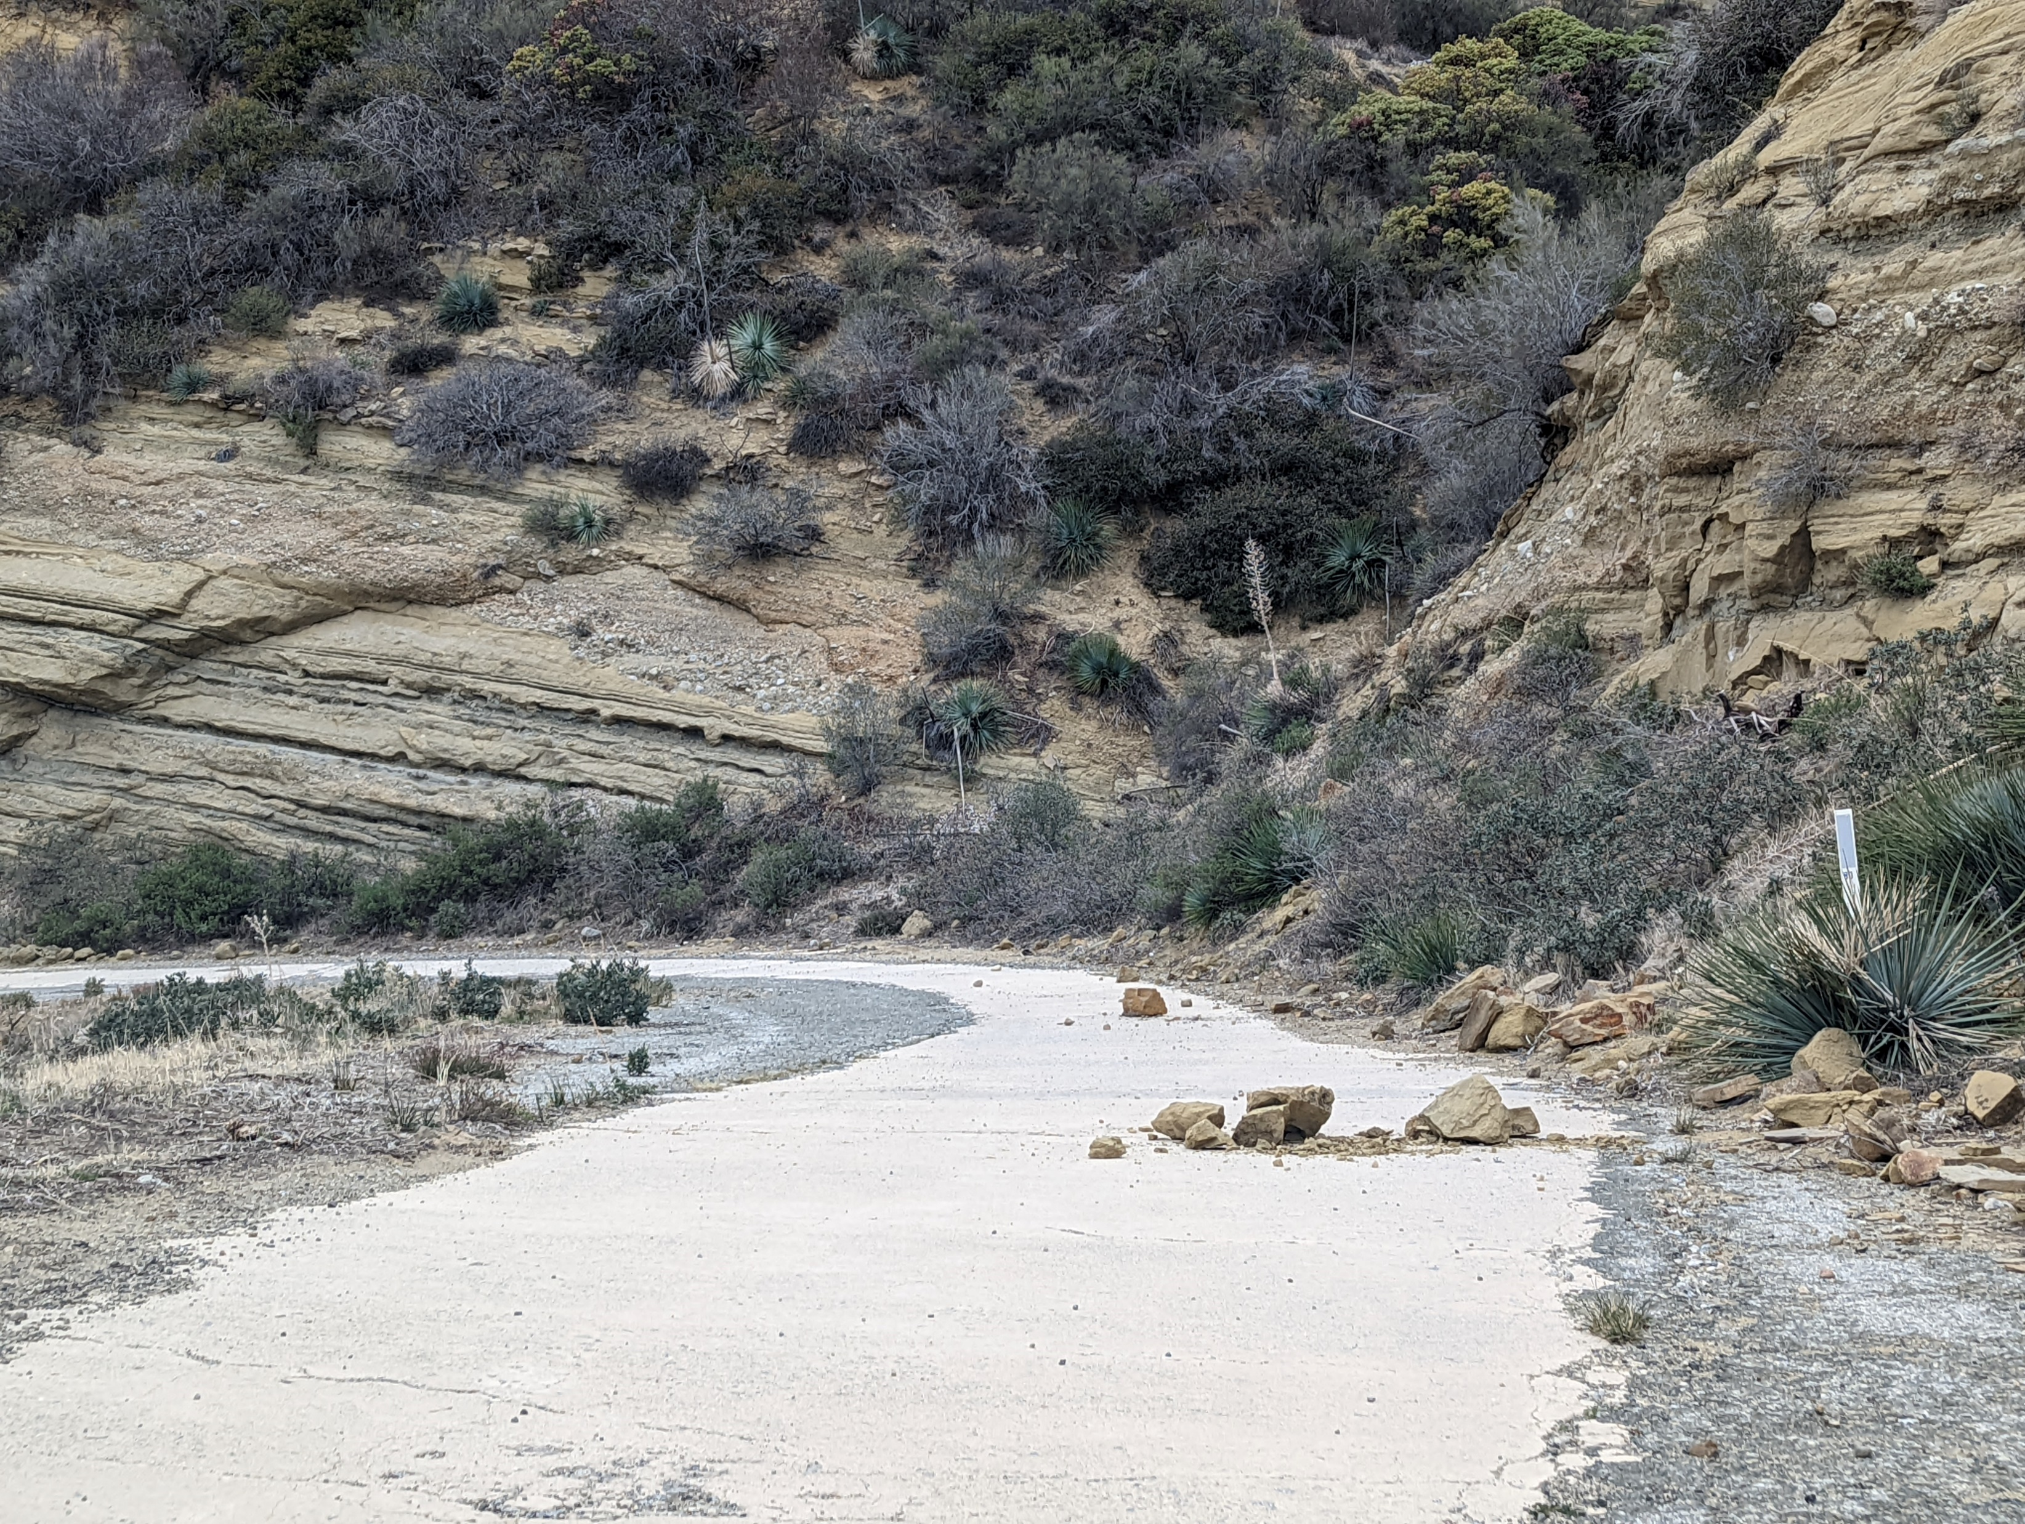
Ridge Route Meeting
February 10, 2022

Slide 2
Joint USFS – RRPO Roadway Plan
What is needed to reopen the roadway?
Proposal from the RRPO
Open Spring to Fall to avoid Winter conditions
Continued maintenance of the roadway after reopening
Where will be money come from?
Proposals for the existing cultural resources
Upgrading existing monuments along the road
Protect historic locations along the road using barriers
Add mile markers to better manage maintenance and assist navigation

Slide 3
Proposal from the RRPO
Repair or stabilize existing sections of damage concrete with exposed reinforcement.
Repair or stabilize existing sections of historic asphalt with potholes to reduce further degradation.
Stabilize erosion at critical points along the roadway to increase safety for travelers
Post signage at both ends of the roadway prohibiting large trucks and similar heavy vehicles including buses that could damage the historic roadway.

Slide 4
Proposals for existing cultural resources
Existing monuments are damaged and illegible.
New interpretive plaques needed
Work should begin once the roadway opening date is closer
Possible upgrading of existing monuments with small shelters
Protection of historic sites using barrier systems to prevent vehicles damaging sites

Slide 5
Continued Maintenance
After the roadway is reopened, increased traffic may damage the roadway.
Regular maintenance will be necessary
Potholes and exposed reinforcing bar must be repaired (as needed)
Rockfalls must be cleared (monthly, if possible)
Culverts must be maintained on a regular basis (annual)

Slide 6
Funding
Funding sources will be needed
Utility Access Permit Fees
OHV Grant Money for OHV Approved Sections
Legislation?

